Slide 1

Dr Andrew Nance
SAPN People’s Panel, 4th March 2023
Export Tariff Deliberations

Slide 2
Agenda
Recap: Why focus on the Consumer?
Recap: Who’s who in the Zoo
Recap: Network Tariffs = delivery fees
Andy’s Electricity Bills
The problem to be solved: Lots of solar, Network getting congested (the $ from the Energy Transition focussed conversation)
The Question posed to the Panel
Tariff Principles developed in 2016 ?
Intro to Bryn and Helen from SA Power Networks
What other networks have proposed – timing: Mandatory, Opt in and Opt out

Slide 3
Why focus on the Consumer?
Adam Smith – Wealth of Nations 1776
Consumption is the sole end and purpose of all production; and the interest of the producer ought to be attended to, only so far as it may be necessary for promoting that of the consumer.
  An Inquiry into the Nature and Causes of the Wealth Of Nations (1776), Book IV Chapter VIII, v. ii, p. 660, para. 49.
The National Electricity Objective
  “to promote efficient investment in, and efficient operation and use of, electricity services for the long term interests of consumers of electricity with respect to:
  price, quality, safety and reliability and security of supply of electricity
  the reliability, safety and security of the national electricity system."
Consumer vs Taxpayer
The Consumers of 2030 & the effect of uncertainty on all of this

Slide 4
Retailer, Generators and Networks
SA Electricity customers can choose from around 40 different retailers. The majority (around 70%) are with AGL or Origin Energy
AGL and Origin also own significant (gas and renewables) generation capacity and are often called ‘gentailers’. EnergyAustralia, Simply Energy, Red & Lumo (Snowy Hydro) are also gentailers in SA. All of these have gas or diesel generators.
Combined, gentailers retailed to over 85% of small customers in 21-22
However, ALL retailers need SA Power Networks (and ElectraNet) to transport the electricity to customers

Slide 5
What do we mean by Network Tariffs?
These are the “electricity transport and delivery” charges that SA Power Networks recover from you via your Retailer (AGL, Origin etc)
Networks are regulated by the AER on a “Revenue Cap” basis. Once the total revenue is set, this must be recovered from customers
The rules and regulatory guidelines set out that tariffs need to be constructed so as to send a price signal to encourage “efficient” use of the network as well as recover the revenue (up to the regulated cap).
These dual roles of “price signal” and “revenue recovery” is why we have tariffs with fixed and variable parts, time-of-use and “peak demand” charges for larger customers.

Slide 6
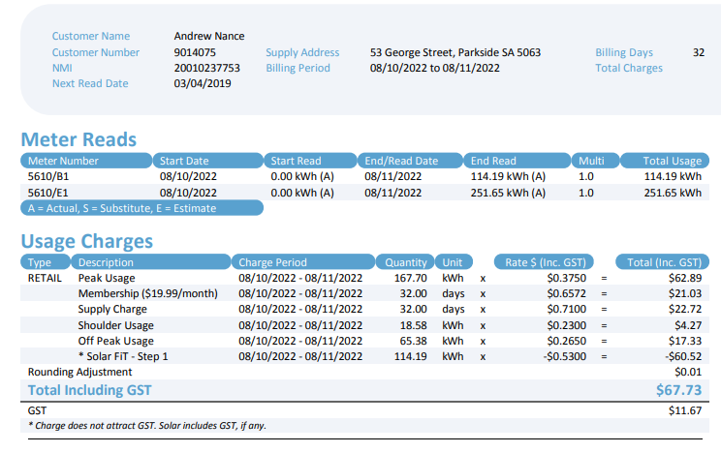

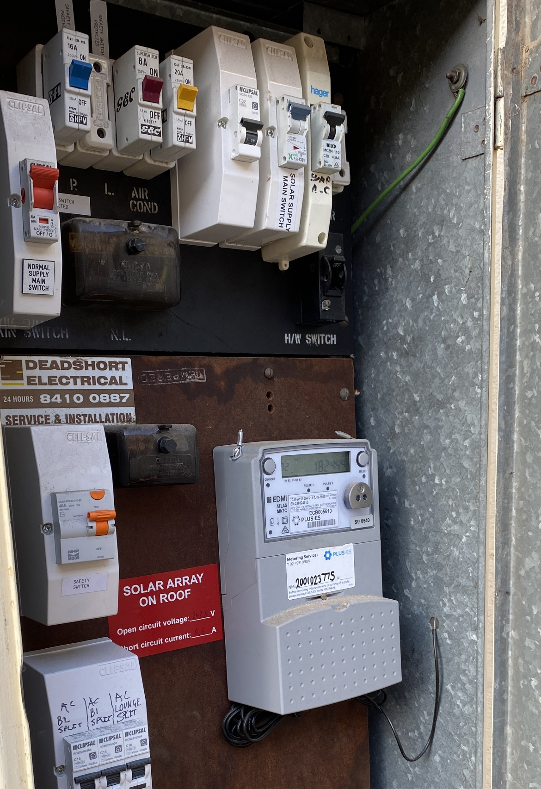
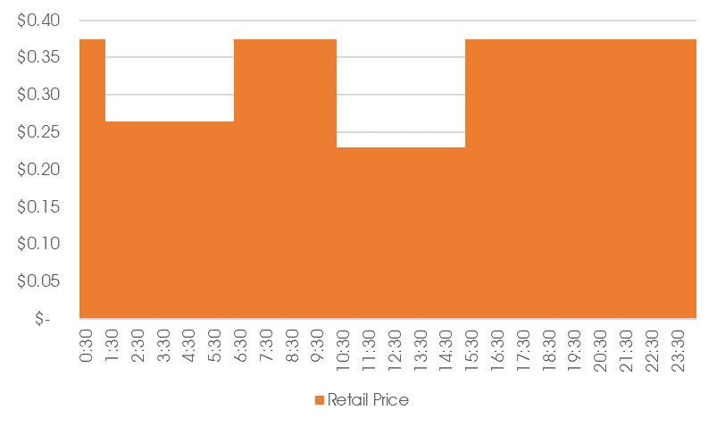
Andy’s Electricity Bills
Exports to the grid
My Big Fat feed-in tariff
Time of Use prices each day
Smart Meter
Antenna for remote reading

Slide 7
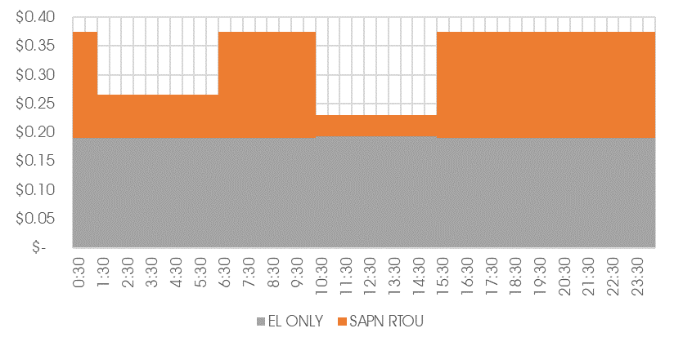
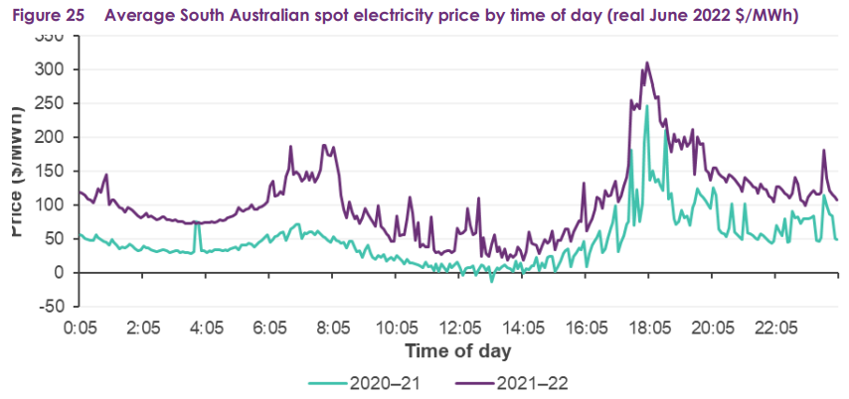
Network vs Retail charges
Peak
Off-Peak
Shoulder

Slide 8
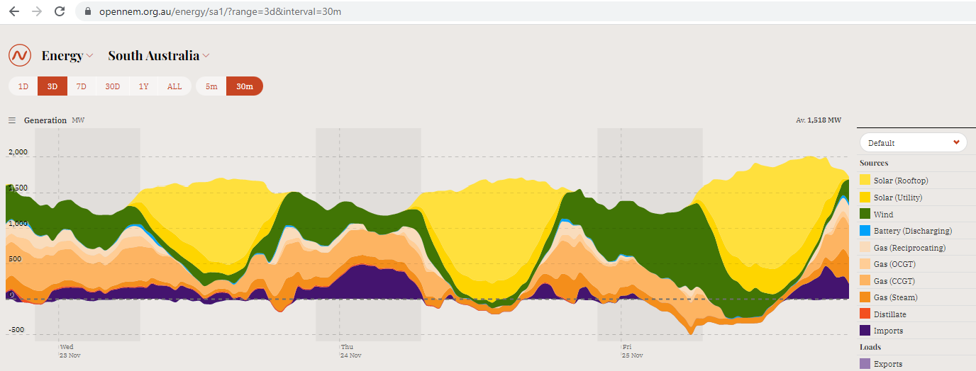
We generate a lot of solar electricity in SA. Most of it is generated on the roofs of households, schools and businesses connected to the SA Power Networks grid
Live Electricity Generation: OpenNEM https://opennem.org.au/energy/sa1/?range=3d&interval=30m

Slide 9
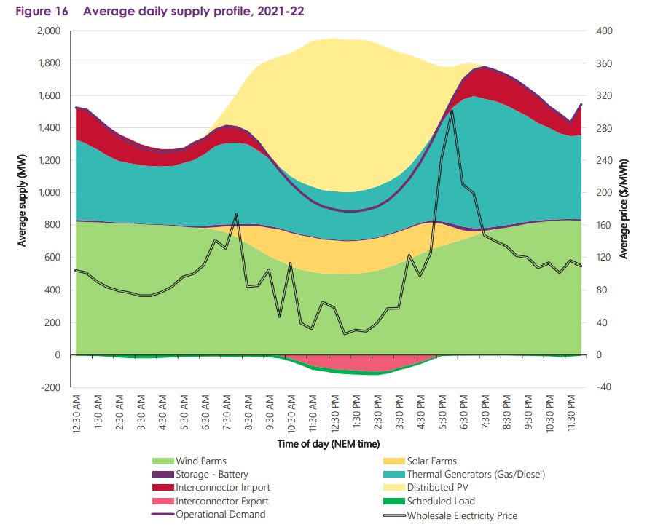

Slide 10
Exports: What the Rules say
2021 “Access and Pricing” Rule Change
Three key components:
Clear obligations on distribution businesses to support energy flowing both ways - Clarification that export services are part of the core services to be provided by distribution businesses
Removing the existing prohibition on distribution businesses from developing export pricing options, which can help get more out of the network infrastructure
Strengthening customer protections and regulatory oversight by the AER - distribution businesses will be required to consult widely and test and trial the options they put forward using export tariff guidelines developed by the AER
SA Power Networks Rule Change Request is here: https://www.aemc.gov.au/rule-changes/access-pricing-and-incentive-arrangements-distributed-energy-resources-retail
Final Rule Change Determination is here: https://www.aemc.gov.au/rule-changes/access-pricing-and-incentive-arrangements-distributed-energy-resources

Slide 11
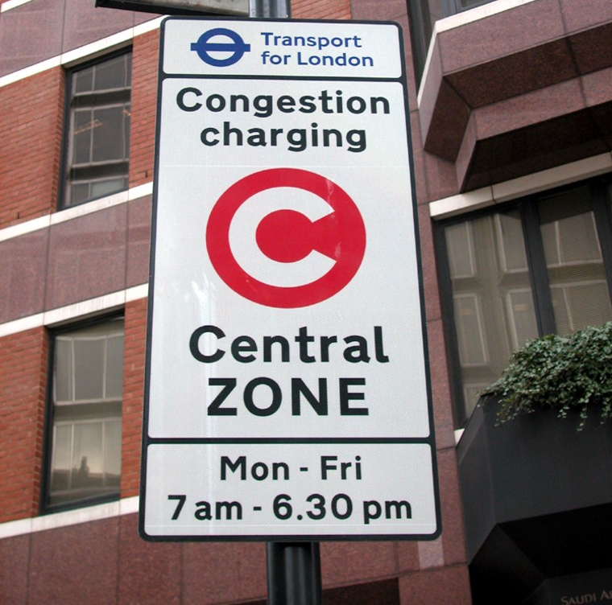
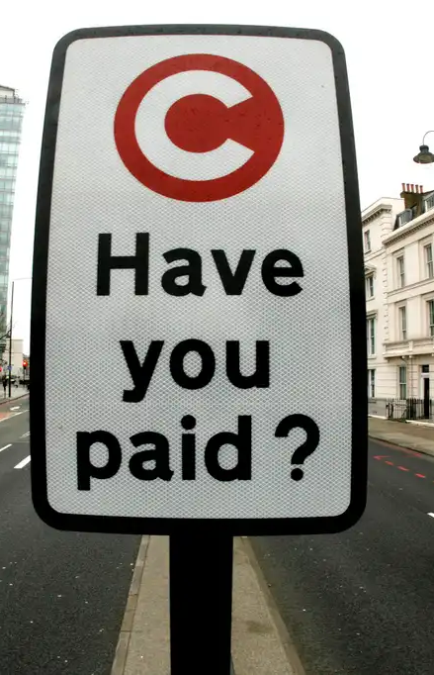

Slide 12
The Question being posed to the Panel
Regulation requires SA Power Networks to consider export tariffs that reflect the cost of providing the service. How can the transition be phased in to maximise fairness and equity for all?
By “transition” we are referring to the “who” and “when”
Options considered by the Focused Conversations refer to different combinations of timing for “NEW” (post July 2023) and “EXISTING” (up to June 2023)

Slide 13
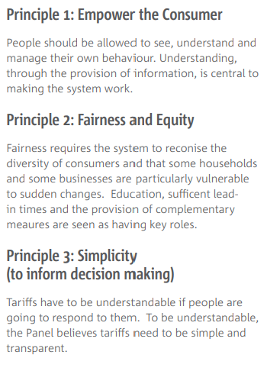
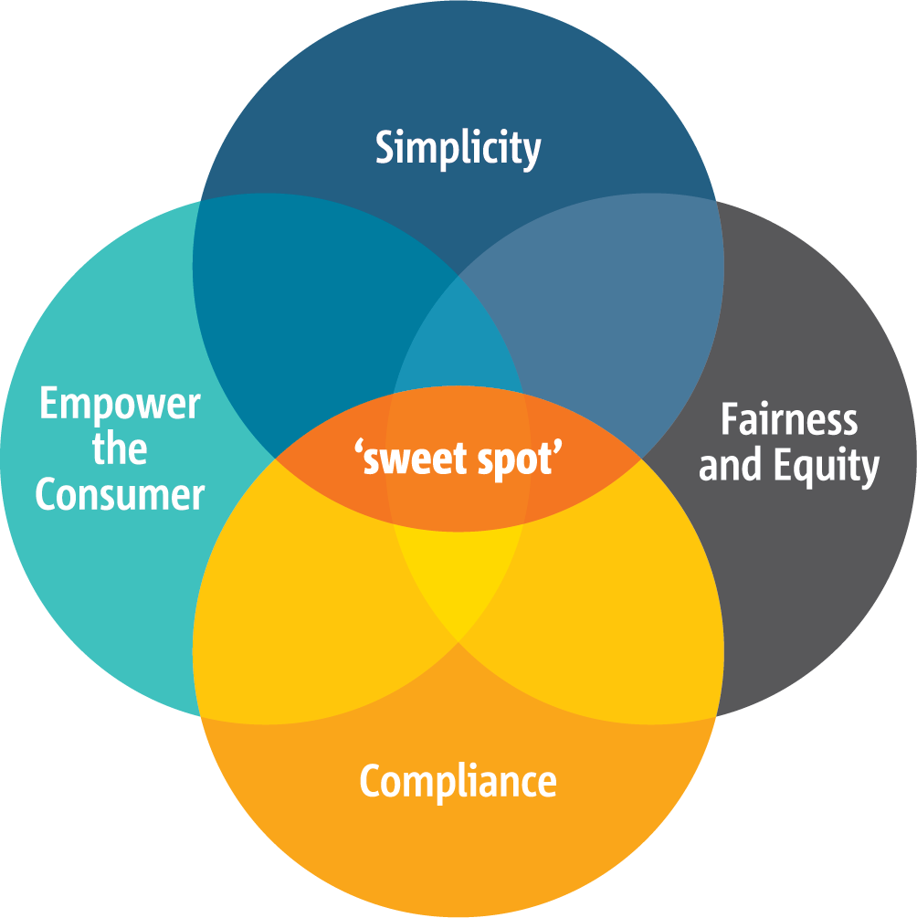
The principles developed by your peers of 2016
Asked by SAPN:
“When we make decisions about network charges, what are the impacts on customers that we need to consider?”

Slide 14
Next …
Next, Bryn will talk about what the rule change means in the SA context
Then, Helen will present the export tariff options considered by the Focussed Conversation process
Then, I’ll come back to present what the NSW and ACT Networks are proposing

Slide 15
What are other Networks proposing?
The three NSW Distributors and the ACT distributor are one year ahead in their regulatory cycle and have made their formal proposals to the AER for the period 2024-29
All four are proposing “Distributed Energy Resources Integration” expenditure and export tariffs
They are all slightly different – reflecting their circumstances around solar uptake and the “intrinsic hosting capacity” of their networks

Slide 16
Ausgrid (Eastern Sydney and up to Newcastle)
Ausgrid
DER Integration Expenditure (5 years) | $126.1m
Basic Export Level | 2,500 kWh pa = 6.85 kWh per day
Export Charge Time Window | 10AM to 3PM
Export Reward Time Window | 4PM to 9PM in peak period (NOV-MAR + JUN-AUG)** I think …?
Transition
New Customers: | Residential and small business
Mandatory/Opt-in/Opt-out | Opt-in FY2425, Mandatory from 1 July 2025
Existing Customers: | Residential and small business
Mandatory/Opt-in/Opt-out | Opt-in FY2425, Mandatory from 1 July 2025 if have an interval meter

Slide 17
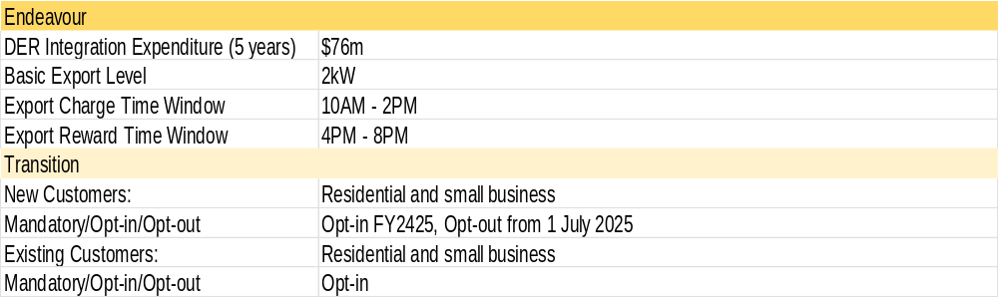
Endeavour Energy (Western Sydney +)

Slide 18
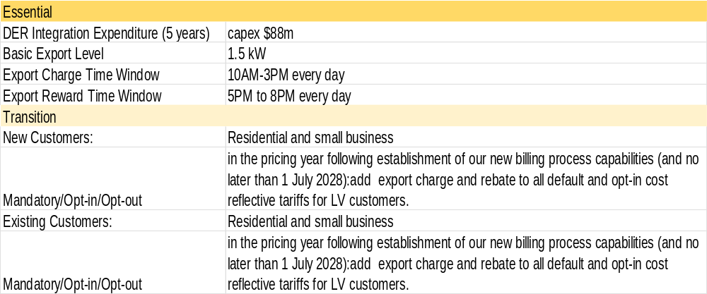
Essential Energy (Regional NSW)

Slide 19
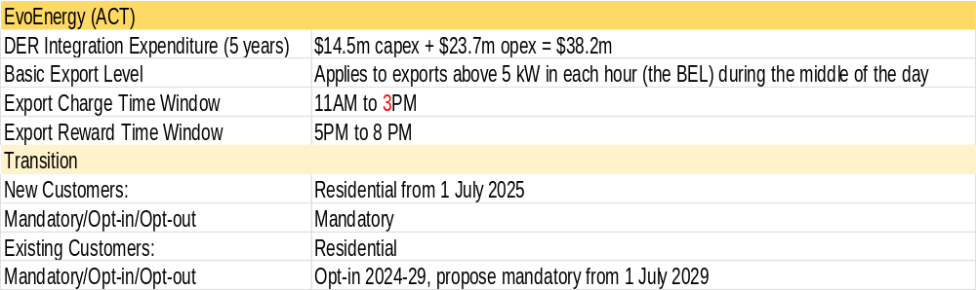
EVO Energy (ACT)

Slide 20
Short history of electricity in SA
SA Electric Light and Motive Power Company 1895
Federation 1901: Electricity not mentioned in Constitution – responsibility falls to the States
Adelaide Electric Supply Co c1905 (privately owned from London)
  Grew rapidly from 600 customers in 1904 -> 60,000 by 1926
  Relied on Coal from NSW, refused SA coal from Leigh Creek
Premier Tom Playford initiated Royal Commission in AESCo in 1945 -> nationalisation
Electricity Trust of SA (ETSA) takes over 1 September 1946
Corporatisation and disaggregation in the 1990’s
Privatisation process 1998
Generators and Transmission sold separately
CKI consortium purchases ETSA Utilities (Distribution and Retail) 12 December 1999
On-sells retail part to AGL …
“Full Retail Contestability” for electricity customers from January 2003

Slide 21
Resources
Australian Energy Statistics https://www.energy.gov.au/publications/australian-energy-update-2022
AEMO SA Advisory Functions https://aemo.com.au/energy-systems/electricity/national-electricity-market-nem/nem-forecasting-and-planning/south-australian-advisory-functions
ABS CPI https://www.abs.gov.au/statistics/economy/price-indexes-and-inflation/consumer-price-index-australia/latest-release#data-download Table 9
AEMC Residential Price Trends https://www.aemc.gov.au/market-reviews-advice/residential-electricity-price-trends-2021
AER – Retailer and Network performance data https://www.aer.gov.au/retail-markets/performance-reporting and https://www.aer.gov.au/networks-pipelines/performance-reporting

