Slide 1


Slide 2

Acknowledgement of Country
SA Power Networks Acknowledges the multiple Traditional Owners of the lands that host the South Australian electricity network and their connections to land, sea, and community.
We would also like to pay our respects to all First Nations’ Peoples past and present and acknowledge these living cultures.
Notes:
SPEAKER NOTES:
We begin today with an Acknowledgement of Country (read through the Acknowledgement as per the slide.)
TIPs:
Add your own Indigenous artwork
Or visit here for First Nations ethical resources that can be used for free Acknowledge Country Posters — KNOW YOUR COUNTRY
PROMPTs:
Can also include the name of the specific Traditional Lands that you’re on, visit here to find out more Whose Country am I on? | AIATSIS
If the session is online and there are attendees on other Traditional Lands, encourage them to put this in the online chat.

Slide 3
Welcome
This is module 2 of our Energy Literacy program:
Module 1 – Introduction to energy and your energy bill
Module 2 – Saving energy and money
Focus is on simple, easy tips and tricks to remember
Relaxed session, feel free to ask questions!
You will receive a take home guide to help remember key points
Notes:
SPEAKER NOTES:
About the session…
Today is an introduction to energy in your home
It is the second of two sessions
This session is looking at 2. Saving Energy and Money
This session should take about 2 hours and there is plenty of time to ask questions
Remember if you have a question, more than likely someone else has the same question so please feel free to ask us if you want to know more.
About me and those that have helped today…
I’m here today from (insert organisation) our role is (insert brief role description)
Emergency exits, housekeeping etc

Slide 4
Module 2 - Learning Objectives
The main things we want you to take away from today:
Understand how energy is used in the home
Learn easy ways to save energy
Know how to heat and cool your home efficiently
Understand how to choose energy-efficient appliances
Notes:
SPEAKER NOTES:
There are 4 learning objectives that summarise the main things we would like you to take away from today.
These are:
Understand how energy is used in the home
Learn easy ways to save energy
Know how to heat and cool your home efficiently
Understand how to choose energy-efficient appliances
There will be a lot of information but don’t worry – we will give you some take home information to refer back to.
Let’s get started.

Slide 5
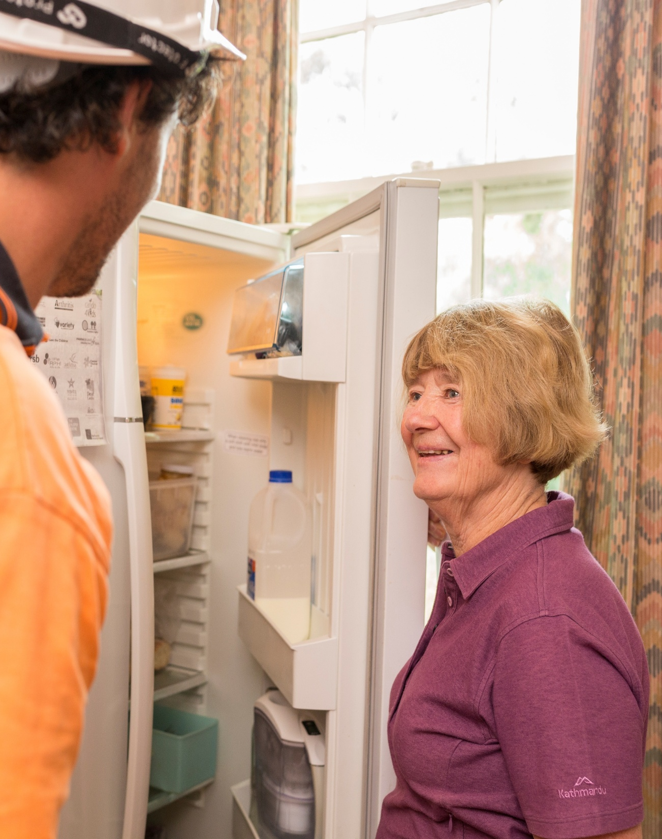
Agenda
Today we will talk about
  Why save energy?
  Using energy in your home
  Keeping the home cool or warm
  Using hot water and lighting in your home
  Using and buying energy efficient appliances
  Saving energy when renting
  Your take-home action plan
Notes:
SPEAKER NOTES:
Today we will talk about
Why save energy?
Using energy in your home
Keeping the home cool or warm
Using hot water and lighting in your home
Using and buying energy efficient appliances
Saving energy when renting
Your take-home action plan
We want to make this training relevant to you – so at the end we hope everyone will have 2 things to put down on their ‘take home action plan’ from today’s session

Slide 6
1 – Why save energy?

Slide 7
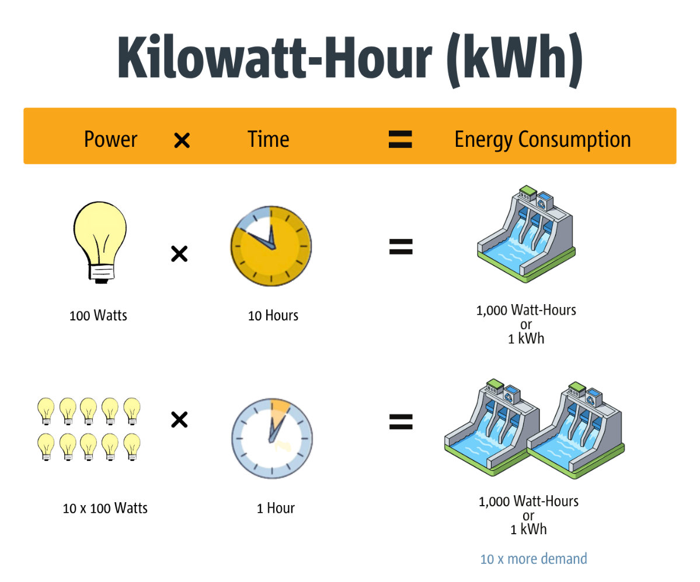
1. Refresh on kWh
Let’s refresh on kWh
A kilowatt hour is the measure or metric for measuring electricity use.
The more appliances you have in use, turned on, the more electricity you use.
The more watts or kilowatts those appliances use, the more electricity you use.
Notes:
SPEAKER NOTES:
What did we go through in Module 1 – refresh on kWh
Go through diagram
A kilowatt hour is the measure or metric for measuring electricity use.
It is how you are billed for electricity by your retailer.
The more appliances you have in use, tuned on, the more electricity you use.
The more watts or kilowatts those appliances use, the more electricity you use.
We will look at how to reduce your electricity consumption and cost in this module.

Slide 8
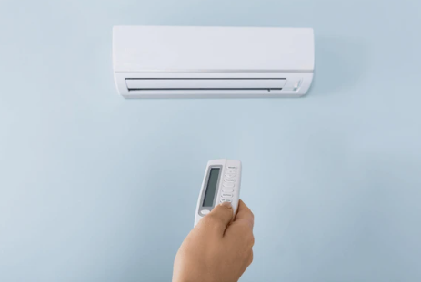



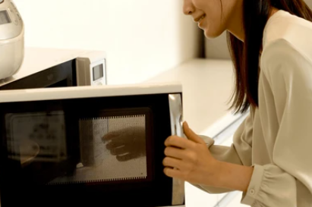
1. What is saving energy?
In our daily lives, we use lots of energy. Sometimes more than we need to.
Efficiency
Reducing use and getting the same benefit
Conservation
Going without to reduce use and cost
Let’s discuss how we use energy in the home
Notes:
SPEAKER NOTES:
In our daily lives, we use lots of energy. Sometimes more than we need to, and sometimes we go without to save energy and money.
Let’s have a think about how we use energy in the home.
Efficiency = reducing use and getting the same benefit
Includes having more efficient appliances – usually new appliances, or modern technology. This is using a heat pump clothes dryer instead of the older style dryer, a new fridge, even a new TV.
Using a high star rated reverse cycle AC instead of a plug-in heater for a small room
Boiling a kettle for just one cup, instead of the whole kettle
Using an air fryer to cook your dinner instead of the oven
A 3-minute shower instead of filling the bath – reducing your hot water use.
Conservation = going without to reduce use and cost
Not turning on lights in the rooms you use, or buying only a couple of lights for the whole house and moving them between rooms
Not using any heating or cooling, even if its available, even if it impacts your health and wellbeing
Turning off your electric hot water system for 2 or 3 days at a time, using the residual heat for your hot water needs
Optional narrative (from Voices for Power)
Let’s imagine being at home…
Ah… hanging out at home.
It’s nice and cosy with the lights and the heating or cooling is on.
Your phone charging while you message your friends, your little brother watching his favorite TV show.
But hang on a minute, how much energy are you using here?
Some of the energy we use comes from fossil fuels, like burning gas to make heat, cook food or generate electricity.
That burning releases carbon dioxide into the atmosphere, which causes climate change.
Some of our energy comes from renewable sources, but we still don’t have enough of them.
So, we really need to save as much energy as we can!
Or
Back at home…
Dad’s filled the kettle to the very top when all he wants is one cup of tea.
Kettles use loads of energy while its heating, so if you want one cup, boil enough for one cup!
We can also do lots of little things to save energy.
If you’ve only worn your clothes just once or twice, do they really need to go in the wash?
And when you leave a room, always remember to switch off the light, the radio, the TV……unless someone else is still using them, of course!
You can even save energy in the bathroom.
Baths use up lots of hot water, and a lot of energy to heat that hot water!
A quick 3-minute shower will do the job.
(ref: https://www.bbc.co.uk/bitesize/topics/zt3k96f/articles/zxxg3j6#zfxqp9q)

Slide 9
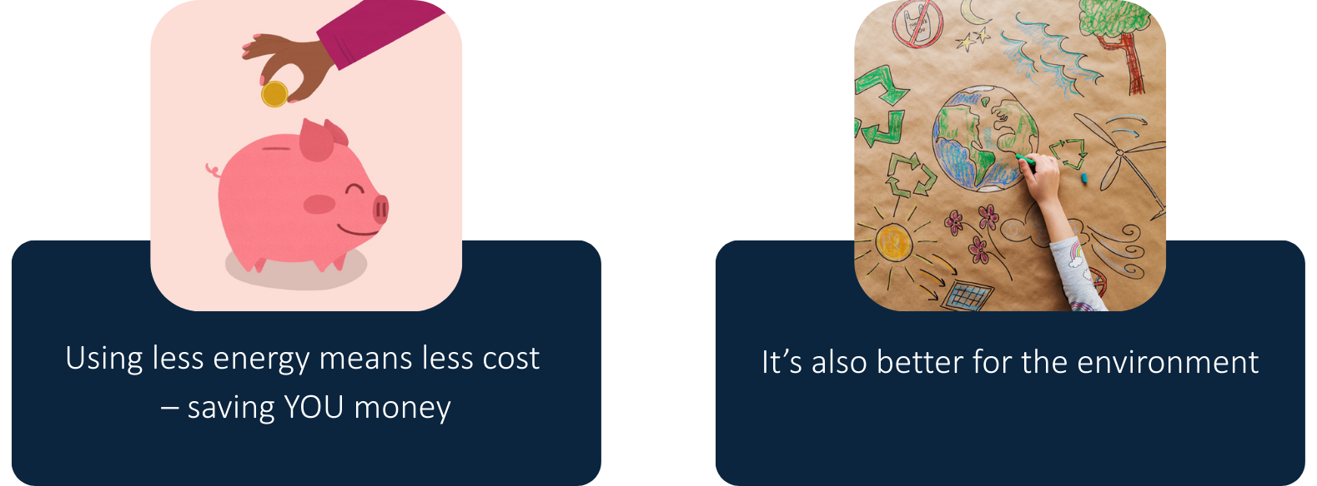
1. Why save energy?
Notes:
SPEAKER NOTES:
Why do we need to save energy?
There are two main reasons to save energy… firstly using less energy means less cost to you. The second is that it is also better for the environment, making it a better healthier place to live for us and the whole community.
Much of the energy we use on a daily basis comes from fossil fuels (coal, oil and gas).
These are non-renewable sources of energy, burning fossil fuels pollutes the environment and can make us ill.
It releases carbon dioxide, a greenhouse gas that contributes towards global heating and climate change.
However, this is changing - SA is leading in terms of grid renewables
There are now lots more sources of renewable energy, like wind farms and solar farms, and although better for our environment, it still uses resources to build and maintain.
These all need lots of resources to make them, so it’s still a good idea to reduce the amount of energy we use.
Time of Use
With more solar available, we are also being asked to change the time of day we use most of our electricity.
Electricity customers are being encouraged to use more in the middle of the day through a Time of Use tariff, which we went through in Module 1.
ref: Saving energy at https://www.bbc.co.uk/bitesize/topics/zt3k96f/articles/zxxg3j6#zfxqp9q

Slide 10

ACTIVITY
Your Energy Priorities
Activity
5 minutes
Your Energy Priorities
“When you are using energy in your home, what’s most important to you?”
Review cards on the table
Pick the top 3 that are most important to you
Pick a partner and share with your partner
We will come back as a group and invite volunteers to share
Notes:
SPEAKER NOTES:
If required, e.g. if not immediately following on from the first module
Go around the room and ask people to introduce themselves
ACTIVITY:
Start with a short activity to get people comfortable and thinking about energy
Review cards on the table
Pick the top 3 that are most important to you
Pick a partner and share with your partner
We will come back as a group and invite volunteers to share
PROMPTS:
Open up to the group for sharing.
Write down on note paper / whiteboard, what are the common themes?
Hopefully, we can address these today.

Slide 11
2 – Using energy in your home
Notes:
2 – Using energy in your home

Slide 12
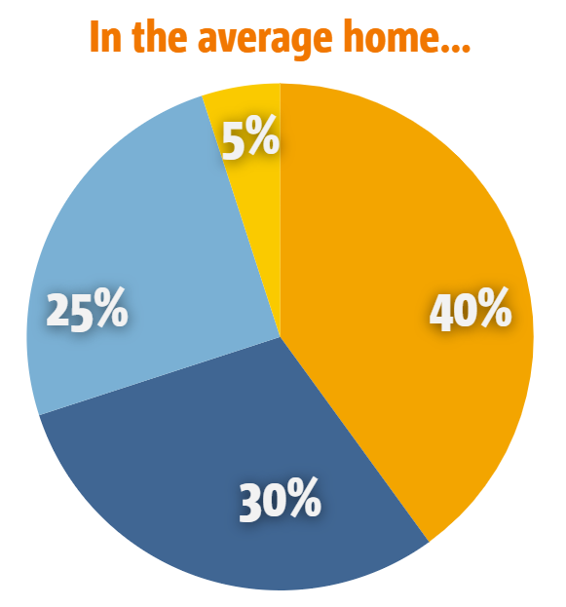

2. Using energy in your home
Let’s look at the SA Government estimated average energy use in the home by cost*
What do you think costs the most?
Looking at the options, which one do you think uses
Hot water?
Heating and Cooling?
Lighting?
Appliances?
Notes:
SPEAKER NOTES:
Let’s have a look at what the SA Government estimates is the average energy use in our homes.
This includes gas and electricity
PROMPT:
Look at the pie chart – what do you think uses the most energy at 40%? What do you think uses 30%?
Ask participants to chat about this
Move to next slide to reveal results
Power usage, savings and efficiency | Energy & Mining
https://www.energymining.sa.gov.au/consumers/power-usage-savings-and-efficiency

Slide 13
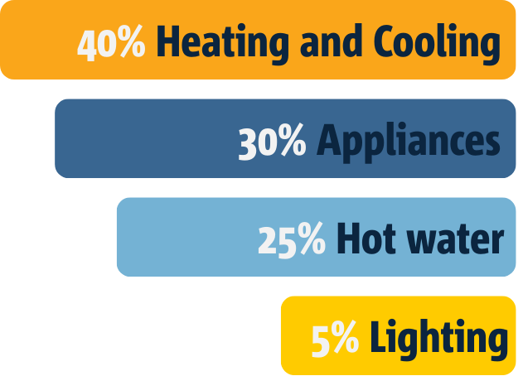
2. Energy use in the home
Notes:
SPEAKER NOTES:
Here are the results – This is what the SA Government estimates is the average energy use in our homes.
Heating and cooling about 40% of household energy use
Appliances about 30% of household energy use
Hot water about 25% of household energy use
Lighting about 5% of household energy use
SPEAKER PROMPTs:
Are you surprised by this?
Does look right for your home?
Is your household different in any way?
NOTE: This may look different if you have
Gas appliances
Pool or spa
Fire heating
Did you know some retailers are able to help you understand what your home’s energy use breakdown is? AGL Energy Insights is one example, which is a feature in its app which breaks down your energy use like this.
References
https://www.energy.gov.au/households/quick-wins
https://www.qcoss.org.au/project/energy-and-water/
https://www.energymining.sa.gov.au/consumers/power-usage-savings-and-efficiency

Slide 14
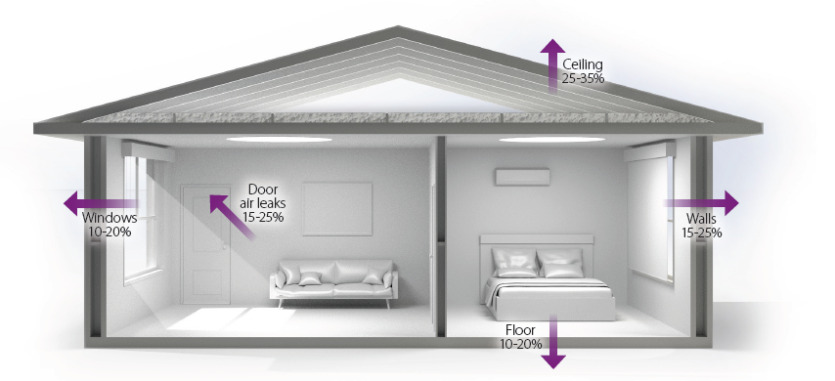
2. A comfortable and affordable home is more than energy
Thermal efficiency of a home is how well it keeps heat in during winter and out during summer, using the least energy possible.
Tip: Does sun hit your windows?
Winter: Keep the curtains open on a sunny day to heat your house.
Summer: Close them to block the heat out.
Notes:
SPEAKER NOTES:
The thermal efficiency of a home is how well it keeps heat in during winter and out during summer, using the least energy possible.
There are many factors that can affect your thermal efficiency:
Insulation in ceiling and walls can significantly reduce heat loss and gain (e.g. Insulation can help reduce up to 60% of heat lost through ceiling and walls)
Draught proofing: sealing gaps in your home (closing draughts under and around doors and windows, through exhaust fans, and behind cupboards, for example)
Window coverings: up to 20% of heating can be lost through your windows; the thicker the fabric and closer it fits the to wall, the better.
Floor coverings: Laying down rugs can help stop losing heat through floor
NOTE: This diagram is showing loss of heat during winter; the reverse is true in summer when trying to keep cool
PROMT:
Ask the group ‘Looking at the house diagram of how heat can be lost and gained – does this surprise you?’

Slide 15
3 – Keeping your home cool or warm
Notes:
3 – Keeping your home cool or warm

Slide 16
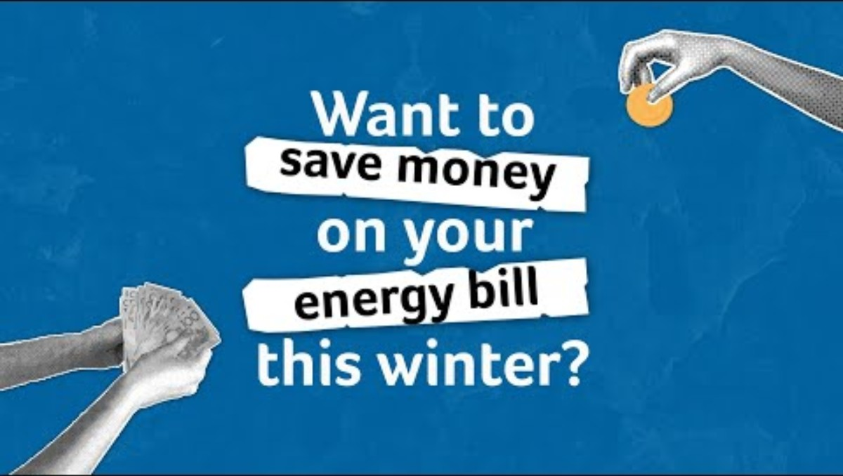
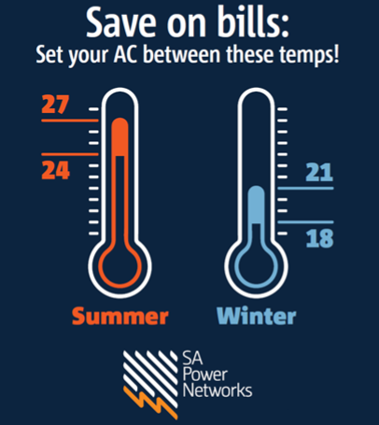
3. Keeping your home cool and warm
Tip: Set your heating between 18-21 degrees in winter, and 24-27 in summer on cool. Every degree above or below this can increase costs by 10%.
Handout – Energy Advisory Service summer cooling and winter heating guide – it shows heating and cooling appliances and their costs to run per hour on different tariffs
Notes:
SPEAKER NOTES:
Let’s start with a short video on how to save money on your energy bill…
Video embedded in slide – link if needed: https://youtu.be/Fl9gmwLnWRA?si=AvkqpnlXUXzU3xR1
SPEAKER NOTES CONTINUED:
Let’s have a look at these costs more closely and see how we can reduce them, saving energy and money!
So, heating and cooling on average is the biggest cost at about 40% of every household…
PROMPT: Ask attendees for their idea on efficient heating and cooling then add the ones that haven’t been mentioned
Are there tips and tricks that you use in your home to keep it cool or warm?
Great! Some really good ideas for us all. Here are other ideas that may help….
*name an extra few and only the ones that aren’t mentioned
Close off the rooms you’re not in using. Shut doors and vents to unused areas and only heat or cool the rooms you’re using.
Filling gaps to stop your warm or cool air from escaping could cut your energy bill by up to 25%.
Use a draught stopper to prevent air leaking under doors.
Apply weather seals to windows, skirting boards, skylights and cornices. *If renting, check with your landlord or property manager before fitting any weather seals.
Improve how your windows work. Prevent heat getting out or coming in with closely-fitted curtains or cellular blinds to trap the layer of air next to the window.
Open curtains in winter to let the sun in during the day and close them before it gets dark. Close curtains during the hottest part of the day in summer.
Catch the breeze: In summer make the most of natural airflow in the cooler parts of the day by opening windows to bring in the breeze and let the hot air out.
Fans improve comfort levels so you feel about 3°C cooler. They need to be blowing on you to feel their cooling effect, as they cannot cool a room. They are a low-to-medium cost to buy and are very cheap to run at only around 2 cents per hour.
Use fans to circulate hot air in winter. Using ceiling fans to push the air downwards in winter improves heating efficiency.
Where this option exists, the fan or remote control should clearly indicate the winter setting to reverse airflow.
Control your climate. In winter, set your heating between 18°C and 20°C. In summer, set your cooling between 25°C and 27°C.
For every degree you increase heating and cooling, you increase energy use between 5% and 10%.
HANDOUTS:
SAPN ‘Save on Bills’ magnet
Energy Advisory Service’s Summer cooling and winter heating guide
ref: https://www.energy.gov.au/households/quick-wins

Slide 17
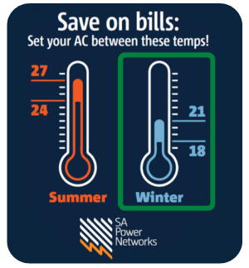
3. When it’s cold…
Heat wisely
Use curtains
Stops draughts
Notes:
SPEAKER NOTES:
There was a lot of information there about heating and cooling, let’s do a quick re-cap so you know what to do throughout the year.
Quick tips to save energy AND money when it’s cold…
Heat wisely!
Turn down your heater (set between 18°C and 21°C). Every degree lower can save 5 to 10% in heating costs.
Wear warm clothes instead of heating the house.
Only heat the room you are using by closing off vents and doors of rooms not in use.
Use low-cost heating appliances – like electric blankets on your bed
Use curtains!
Use curtains to trap heat in. Up to 40% of heating can be lost through windows.
Ideal curtains have a close fit around the window, are thick and/or insulated and covered at the top.
Stop draughts!
Draught proof your home. Filling gaps to stop warm air escaping can save 25% in heating costs.
Insulation and more efficient heating and cooling systems can help you save even more.
You can save 30% or more on heating costs by installing ceiling insultation.
Any other ideas? What else is front of mind for you?
Heat bags
Fans for keeping warm (if they have winter seating DC reversible), also fans in heated room to push warm air onto other rooms
Warm yourself, not the air around you – electric throw, ugg boots, oodies etc.
(ref: https://www.energy.gov.au/households/household-guides/seasonal-advice)

Slide 18
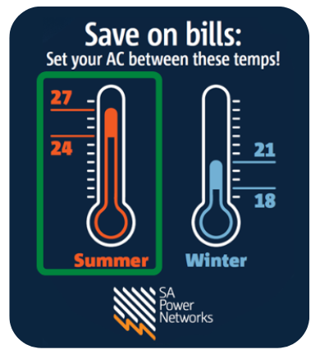
3. When it’s hot…
Cool wisely
Use windows
Stops draughts
Notes:
SPEAKER NOTES:
Quick tips to save energy AND money when it’s hot…
Cool wisely!
Adjust your air conditioner ( to be above 24 on cold or dry) and only cool the rooms you are using. Set to a temperature then let it run to that, don’t turn it off and on. If on TOU utilize cheaper energy during the day to cool house (more detailed info in DEM Home Heating and Cooling Guide)
Every degree higher can save 5 to 10% in cooling costs.
Even better, use a fan first. Fans are cheap to run, costing 2 cents per hour.
Use windows! So different to heating…
Close blinds during the day and open windows at night.
Use curtains that have a close fit around the window, are thick and/or insulated and covered at the top.
Again, Stop draughts and insulate!
Draught proof your home. Filling gaps to stop cool air escaping can save 25% in cooling costs.
Insulation and more efficient heating and cooling systems can help you save even more.
You can save up to 15% on cooling costs with insulated walls.
Any other ideas? What else is front of mind for you?
Use shading to your advantage, put up shade cloth, trees etc, café blinds etc
HANDOUTS:
SAPN ‘Save on Bills’ magnet
Energy Advisory Service’s Summer cooling and winter heating guide

Slide 19
3. More ideas for keeping comfortable…
Catch the breeze
Low-temp lifestyle
Embrace public spaces
Use less appliances
Use nature
Cooler home
Building or renovating
Notes:
SPEAKER NOTES: What can you do to keep comfortable throughout the year.
Heat waves, cold snaps and extreme events are increasing, wherever you live in Australia.
This is part of climate change and one of the most important reasons we need save energy.
Catch the breeze
Funnel the breeze/wind around your home by opening windows, shutters and doors and situating seating areas to take advantage. This can be a warm wind in winter, or a cool breeze in summer.
Put furniture in front of fans to feel their effect and set up pedestal fans where ceiling fans don’t reach.
Buy a indoor/outdoor temperature monitor to discover when the outside temperature is suitable to open doors and windows.
Low-temperature lifestyle
If possible, plan activities and physical pursuits around cooler/warmer times of the day.
Plan trips to the supermarket or other air-conditioned spaces to escape hotter parts of the day.
Open up your home in the evenings to allow cooler air from outside to push out warm air that’s built-up during the day.
Code Blue and Code Red: emergency protocols enacted in hot and cold weather: https://affordablesa.com.au/news-articles/know-the-code-code-red-and-blue
Save energy by using less appliances
Dry clothes in front of a fan during humid weather, it will reduce your energy bill as well as avoid the build-up of moisture that can lead to mould.
While they might cost more upfront, LEDs are much more efficient than other forms of lighting and will save you money over the long term.
Turn unnecessary appliances off during a heat wave – the produce heat – even a small amount. An example is to not cook with an oven in the middle of a heat wave.
Use nature
Keep an eye on the weather forecast and make changes like we’re talking about when it gets hotter, be prepared!
Plant shade trees and vines, shading is vital in hot conditions to reduce the heat entering your home from walls and windows.
Shading is particularly important if your home is made of heavier construction such as concrete or brick, which takes longer to cool down.
Overhead shading can block the higher angled sun in summer for north and south facing openings.
https://www.yourhome.gov.au/passive-design/shading
Build or renovate to suit your climate and landscape
Build your house to suit the climate and landscape by seeking advice form a NatHERS energy advisor early in the design. More here: https://www.yourhome.gov.au/buy-build-renovate
Solar energy and battery storage is becoming even more attractive for households, lowering ongoing energy costs but also supporting future goals – like getting an EV.
Insulation helps to keep the sun’s heat out of your home during extreme temperatures, saving on your energy bills.
Switch to an energy-efficient hot water system Hot water can account for 25% of your energy use.
(ref: Northern Australia living | energy.gov.au)

Slide 20
4 – Using hot water and lighting in your home
Notes:
4 – Using hot water and lighting in your home

Slide 21
Tip #1
A 3 or 4-star rated showerhead could save you hundreds of dollars a year on water bills
4. Using hot water
Hot water can use up to 25% household energy use
Tips to reduce hot water use:
Buy an energy efficient shower head (>9/l minute)
Different hot water systems can vary in cost to run:
  Solar hot water costs very little
  High star rated systems are more efficient
  When your hot water system breaks, have a plan to replace with an efficient option.
Tip #2
Wash in cold water, a hot cycle can use up to 10 times more energy than a cold wash
Notes:
SPEAKER NOTES:
Hot water is about 25% of your household energy use – here’s some tips to reduce your hot water usage
Buy a new shower head
If your shower head uses more than 9L/minute, you could save money by upgrading it.
A 3 to 4-star rated showerhead could save hundreds of dollars a year on water bills. Also known as a WELS 3 or WELS 4.
Test it by performing a bucket test: DIY bucket test:
Get a Bucket: Use a bucket with a known volume, ideally 9–10 litres.
Set to Normal: Turn on the shower to the temperature and pressure you typically use.
Time It: Run the water into the bucket for 15 to 60 seconds.
Measure and Calculate:
If you timed for 1 minute: The amount of water in the bucket is your litres per minute (L/min).
If you timed for 15 seconds: Multiply the litres caught by 4 to get L/min.
If you timed for 20 seconds: Multiply the litres caught by 3.
Other ideas
Get the temperature right, set it to 60°C for storage hot water systems and no more than 50°C on instantaneous systems.
Give your hot water a holiday. If you're away for more than a week, turning off your storage hot water system saves money and energy.
When turning it back on allow time for the water to become hot enough to kill any bacteria that may have grown.
The water must remain above 60°C for at least 35 minutes before you can safely use it. It could take several hours to reach this temperature.
Replacing a hot water system.
If your system fails, replacing it with a suitable energy-efficient model can reduce energy use.
The higher star rating the better.
If you have solar panels – it makes sense to have an electric hot water system, preferable a heat pump and have it heat up during the day.
Does anybody have a pool? (if yes go through below)
An in-ground pool can use 30% of your household's energy - using more than your washing machine, clothes dryer and dishwasher combined.
Keep your energy costs down by selecting a minimum 5-star energy-efficient pool pump at the smallest pump size effective for your pool or spa.
Run your pump at the lowest recommended speed.
A good quality cover also reduces the need for heating in cooler climates.
ref: https://www.energy.gov.au/households/household-guides/life-stages-advice/outdoor-living-guide

Slide 22
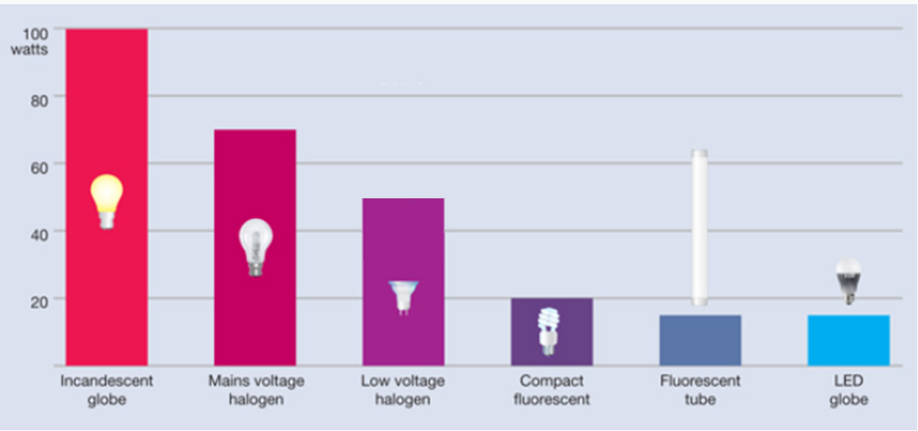
4. Using lights in your home
Lighting can be around 5% of your household energy use
Energy efficient light globes give the most light for the electricity used
They also produce little heat
Use the lowest wattage you can for the space.
Tip: LEDs use around 85% less energy than old-style bulbs and last longer
Notes:
SPEAKER NOTES:
Lighting is approximately 5% of your household energy use – here’s some tips to reduce your lighting
Use natural light when possible (via a window).
Lighter coloured furnishings and reflective surfaces also reduce the need for artificial lighting.
Use lights efficiently. Use reading lamps rather than lighting a whole room.
Switch lights off when you leave the room and consider sensors for outdoor lights.
Switch to energy-efficient LED lighting - LEDs use around 80% less energy than old-style bulbs and last longer too.
Energy efficient light globes give you the most light for the electricity used. Use the lowest wattage you can for the space.
https://www.sa.gov.au/topics/energy-and-environment/using-saving-energy/lighting

Slide 23

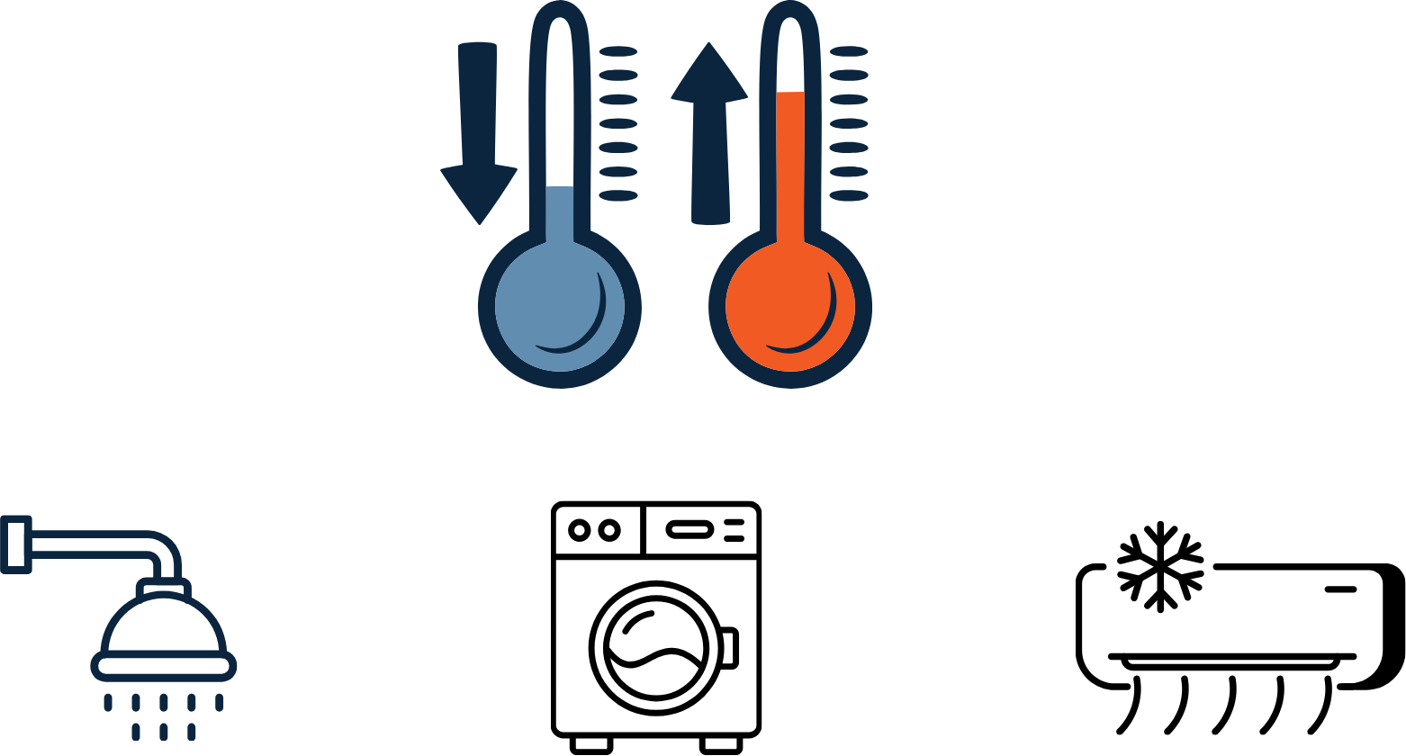
4. RECAP – Check your temperatures
Your storage hot water system… 60c +
Your instant gas hot water system… 50c
Your air conditioner…
24-27C in summer
18-21 in winter
Your washing machine…
Use cold water instead of hot water
Notes:
SPEAKER NOTES:
Let’s recap - The temperature settings on your appliances can increase your energy bills, so it’s a good idea to check your temperature settings and make sure they are working for you.
Let’s have a look at the Australian government's recommended settings:
For hot water systems:
- 60 degrees Celsius for storage hot water systems
- Or no more than 50 degrees Celsius on continuous flow hot water systems
For air conditioners:
- 24 degrees Celsius and 27 degrees Celsius for cooling (in summer)
- Between 18 degrees Celsius and 21 degrees Celsius for heating (in winter)
For washing machines:
- Use a cold-water cycle
- If you must use hot water, keep it below 60 degrees Celsius — a hot cycle can use up to 10 times more energy than a cold wash.
(ref: Why are electricity prices rising in July? How can I cut costs? Your energy questions answered - ABC News)

Slide 24
5 – Using and buying energy efficient appliances
Notes:
5 – Using and buying energy efficient appliances

Slide 25
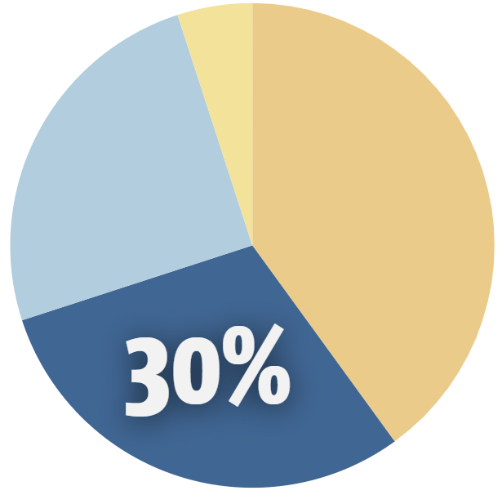
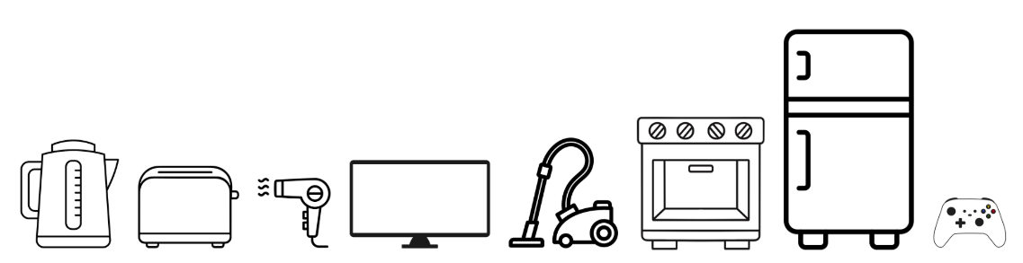
5. Appliances in your home
Appliances use approx. 30% of household energy
Standby power can be up to 3% of household use
Fridges & freezers account for 10% of household energy bill
Small appliances usually use less electricity than larger ones
Tip: Use slow cookers, air fryers and microwaves instead of your oven where possible.
Notes:
SPEAKER NOTES:
Appliances are the next biggest cost at about 30% of your household energy use…
What can you do to keep your costs down when you use appliances?
Your appliances can be both small like a kettle or toaster or big, like a fridge or a dishwasher.
Did you know that:
Standby power can be up to 3% of household use
fridges & freezers account for 10% of household energy bill
Let’s have a look how you can save on your appliances..
Compare the running costs of your appliances, you can use the Energy Rating Calculator or Running Cost Calculator (SA Gov) website to compare running costs of appliances, we’ll have a look at this shortly.
Where you can, buy energy-efficient appliances. The savings can add up over the life of the appliance to more than a higher purchase price.
Washing clothes with cold water can save up to 10 times more energy than a warm wash.
Old fridges & freezers – bad seals, where they are stored etc can use a lot of energy compared to new one. Fuller fridge uses less energy.
Reduce standby power this is when appliances use power when left on, even if not in use, we’ll look at this one more shortly as well.
Important Note: Don't switch off fridges, freezers, security systems and medical equipment to save power.
Any other ideas?
Ref: https://calculator.energyrating.gov.au/
Ref: https://www.sa.gov.au/topics/energy-and-environment/using-saving-energy/calculate-running-costs

Slide 26
5. ACTIVITY
Appliances in your home
Group Activity
5 minutes
Rank the appliances from lowest use to highest use.
Have a look at the flip cards provided - each card has a type of appliance found in the home.
One side has a description of an appliance; the other side tells you how many kwh they use when running.
In pairs / groups of 3, rank the cards you’re given from lowest to highest electricity / kwh use. We will flip them over at the end as a group.
How close were you to guessing the price cost?
Were there any surprises?
Notes:
ACTIVITY:
Appliance Card Game
Layout appliance card game on the floor or table in a random order, with the question side facing up (answer side facing down)
Depending on the size of the group, this could be a whole room game, or broken into pairs or groups of three.
Ask the group to order the cards they’ve been given from lowest to highest electricity use.
As a group, flip the cards over to reveal their usage.
NOTE: The answers are all written out in hours and longer time periods.
SPEAKER PROMPTS:
How close were you to guessing the price cost?
Were there any surprises?

Slide 27
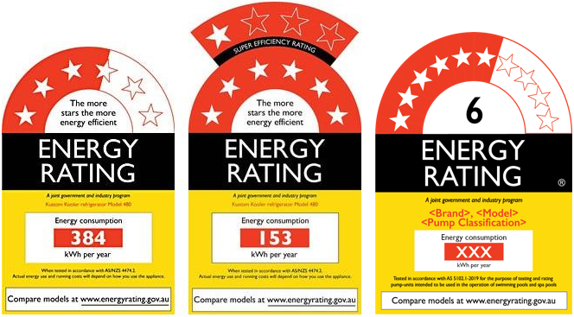
5. What is an energy rating?
An energy efficient appliance may cost more to purchase but is cheaper to run…
Energy Rating: About the E3 Program
Notes:
SPEAKER PROMPTS:
Have you seen these energy ratings before? Watch short 1min YouTube clip about the Energy Rating scheme
Where have you seen them?
What do you think they mean?
Are there any other labels that you look at when buying an appliance? “Eco, green leaves etc”
SPEAKER NOTES: (If not covered in conversation above, see below…)
Energy rating labels provide you with information on the energy efficiency of appliances. This is the ONLY label endorsed by Aust Gov – you TRUST this one.
Energy efficiency refers too how little energy it uses and therefore how you can save energy & money on the appliance.
The more stars, the more energy efficient the product is compared to other models in its category.
The Energy Rating Label is supported by the Australian Government and will cover more household appliances in the future.
OPTIONAL
Follow the link and watch the video
Ref: https://www.energyrating.gov.au/

Slide 28
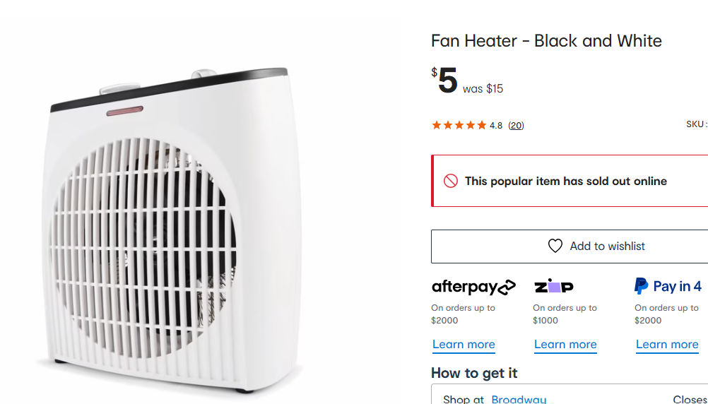
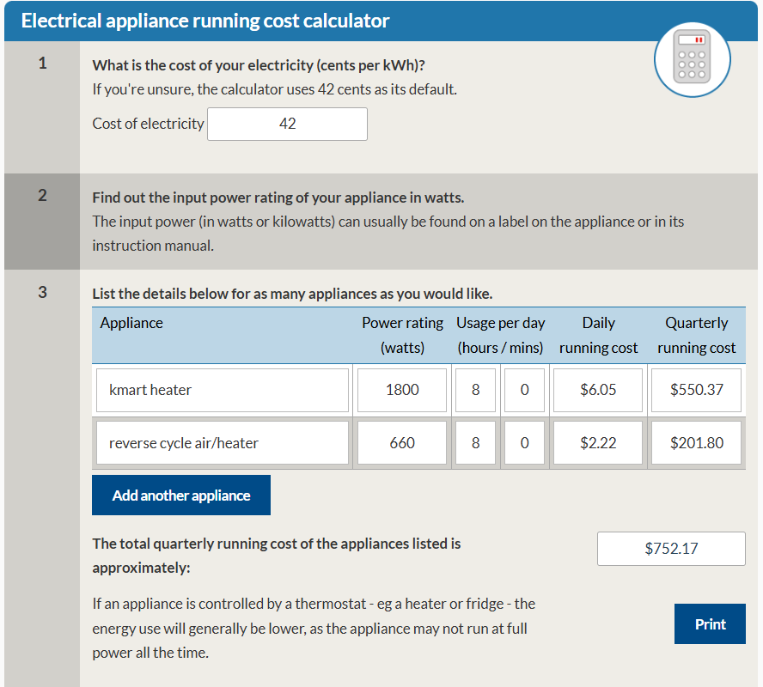
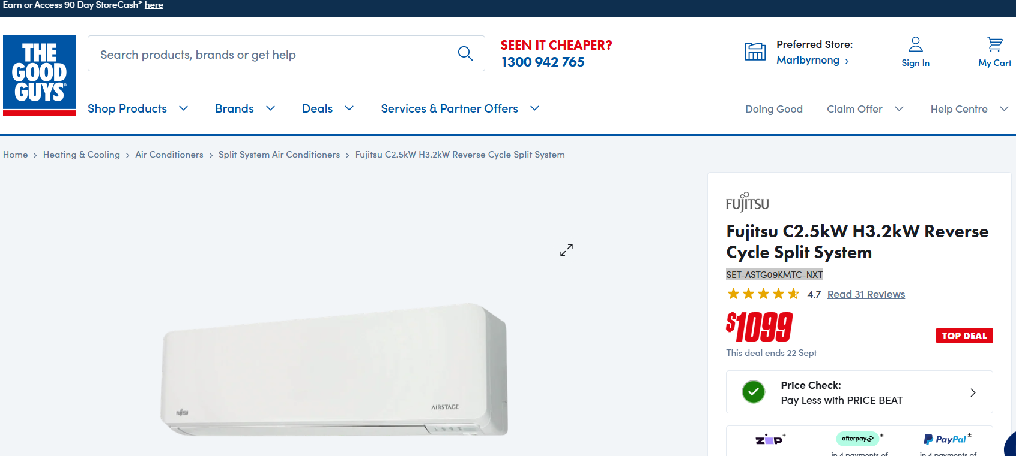
5. Comparing Appliances Costs – Purchase vs Running costs
  Tip: Energy efficient appliances are much cheaper to run and, over time, will cost you less
Notes:
SPEAKER NOTES:
Sometimes the purchase cost of a new appliance is really cheap, but it is energy inefficient and costs a lot to run.
Some appliances costs more when you purchase them but are very efficient so it costs a lot less to run.
Let’s look at an example:
A fan heater costs $5 to purchase new, but it has a daily run cost of over $6, so for running for 8 hours a day would cost $550 for your quarterly electricity bill.
A reverse split system (so you can use it for both cooling and heating) costs $1099 to purchase, but running cost is $2.22 per day. So, for 8 hours a day, it heats/cools a much larger space and only costs a little over $200 for the same quarterly period.
Why is this? This is due to the input power rating; the reverse split system is much more energy efficient.
You can use the SA government website to calculate appliance running costs.
SA.GOV.AU - Calculate appliance running costs (Appliance input power, how to find this information)
https://www.sa.gov.au/topics/energy-and-environment/using-saving-energy/calculate-running-costs

Slide 29
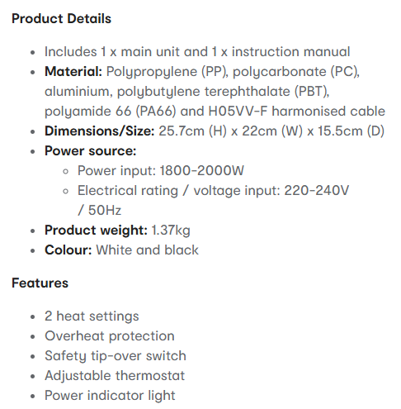
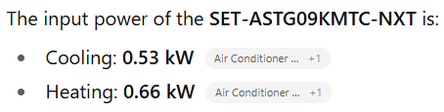

5. Comparing Appliances Costs – Purchase vs Running costs
SA.GOV.AU - Calculate appliance running costs
Notes:
SPEAKER NOTES:
Show SA Gov Calculate Running Costs website
ACTIVITY:
Hand out appliance examples and ask participants to find watts on labels.
Ask them to tell you the watt and nominate a running time per day.
Watch the calculations appear and discuss the difference in prices.
You can use the SA.GOV.AU - Calculate appliance running costs (Appliance input power, how to find this information)
Using the heater examples – you need to find the “input” power
SPEAKER NOTES CONTINUED:
To use this calculator, all you need is the input power, a cost of your electricity e.g. 42c per kWh, and then you can change how may hours a day you are going to use this appliance.
You can see the difference in the cost. The cheaper fan heater cost LOTS more to run and heats/cools a much smaller space than the split system.
RESOURCES/ TIPS:
Have props available: examples such as downlight and halogen globes, an electric blanket, a small portable blow heater, an old sandwich press.
These can be found in your home, in the home of colleagues or at an op shop.
Ref: https://www.sa.gov.au/topics/energy-and-environment/using-saving-energy/calculate-running-costs
(include activity suggestion for on-training)

Slide 30
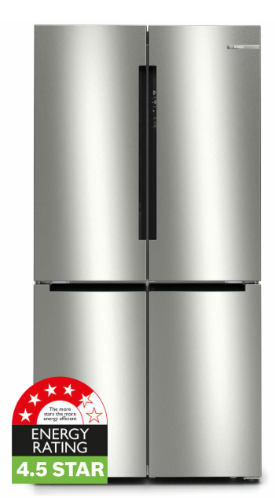
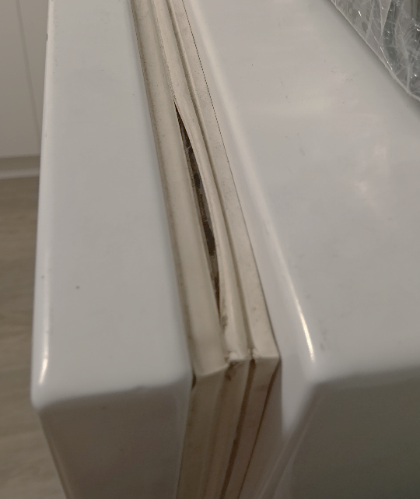


5. Buying new electrical appliances
Look out for
Pay day loans/rent to buy schemes
Hidden costs (i.e. delivery)
Junk insurance
Second hand appliances that end
up costing more
Look out for
Price matching
No Interest Loan Scheme (NILS)
via Good Shepherd
Free delivery and removal of old appliances
Discounts, rebates and grants
High star ratings
Notes:
SPEAKER NOTES:
When the time comes to buy a new electrical appliance, there are a few things to look out for:
Things to be cautious of
Pay day loans and rent to buy schemes may end up costing you much more than the product in the long term. If you miss a loan repayment, the fees are quite high. Rent to buy often charges you much more (sometimes double or more) the value of the product over the rental term.
Are there any hidden cost – like delivery and installation? Do you need to buy anything extra to get value out of it? For example, needing different cookware for an induction cooktop? Specific washing liquid for a clothes washer?
Beware of junk insurance, like product or customer care plans as these products are frequently criticized for covering issues that are already protected by Australian Consumer Law (ACL), such as failures within a reasonable period.
Secondhand appliances may be gifted to you, brought cheaply of marketplace or gumtree, or purchased through a secondhand seller. Although the intention is good and the price is right, these products may cost you more to run in the longer term. Think about fridges with broken seals, energy hungry clothes dryers and plug-in bar heaters.
Good things to look out for (that you want)
Some stores will price match discounts offered at other stores – this is especially true of larger chains. Do some online research first and go prepared with knowledge to bargain.
The No Interest Loan Scheme from Good Shepherd Microfinance is a $2000 loan scheme built for helping people on limited incomes afford essential appliances and service. Whitegoods, laptops, and other appliances are eligible. It is available through community services all around Australia.
If you're buying a big and bulky item – can you transport it? Do you have help to move it inside. What do you do with the old appliance? Some large and small retailers will help you with this free of charge – Appliances Online are both completive and offer free delivery and installation.
Can you get any:
Discounts – i.e. RAA membership, or student or pension card.
Rebate – I.e. REPS – next slide over, or through your council? Many councils offer rebates on electric bikes now – a great alternative to cars, especially over short distances.
Grants – you might be eligible for a grant to help you purchase items – perhaps you’ve been homeless, in long term hospital care, in a DV situation or are seeing a financial counsellor. Talk to you support providers to ask if you're eligible.
Spoken about already – if the product you're buying has a star rating attached to it – buy the highest star you can afford. It will cost less to run in the long term.
Ref: https://goodshep.org.au/services/nils/

Slide 31



5. Buying new electrical appliances
SA’s state government Retailer Energy Productivity Scheme (REPS) provides incentives for South Australian households and businesses to save energy.
Save money on the installation* of
Air conditioners
Hot water systems
Ceiling insulation
& more…
Receive money back for the purchase* of efficient
Fridges & freezers
Heat pump clothes dryers
& a gift voucher when recycling an old fridge
(*) subject to REPS eligibility criteria and available incentives
Notes:
SPEAKER NOTES:
REPS = Retailer Energy Productivity Scheme. This is an SA Government scheme that provides incentives for SA households and businesses to save energy.
You can receive rebates on purchase of new energy efficient appliances.
The current scheme runs from 2026-30. At the time of writing this training, the actual rebate amount and targets for each calendar year have not yet been finalised. This is expected in March 2026, with clearer communication and information available not long after this date.
Some services are already available.
It is recommended that if you, or a client, want to seek a REPS service – contact the activity providers (businesses) on this screen.
If you have difficulty in understanding the process, or can’t find the help you need, feel free to contact Alex from Adelaide Home Energy Assessors and I can help make the connections for you.
The three Activity Service Providers are: YESS – Your Energy Saving Solutions, MAC Trade Services and Ecovantage.

Slide 32
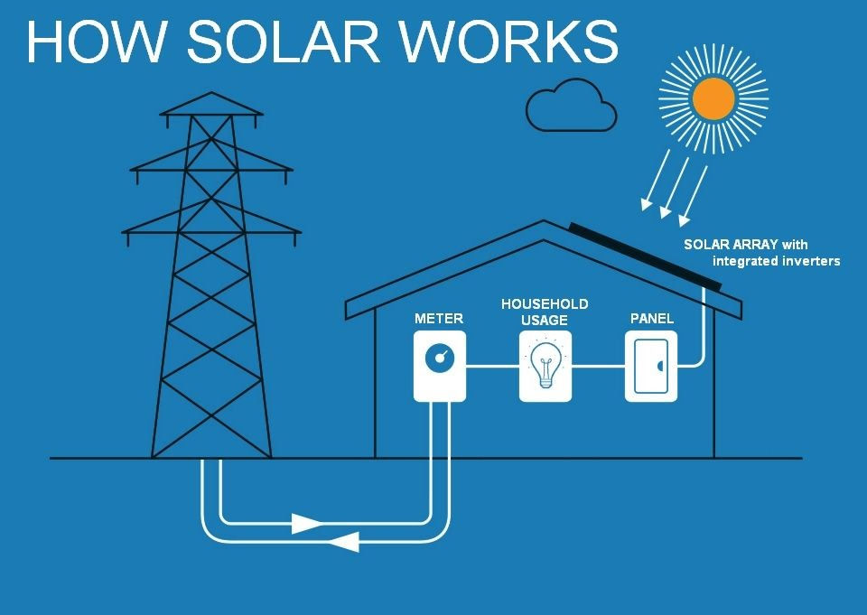
8. What about solar panels?
Things to think about if considering solar and/or batteries
Suitability of your house
Focus on self consumption
Solar Feed-in Tariffs (PFIT)
Use solar during the day
Cheaper Home Battery Program
What are the alternatives?
Buying ‘GreenPower’
Free electricity periods ‘3 for free’ or ‘Solar Sharer Offer (SSO)’
Upgrading appliances!
Notes:
SPEAKER NOTES: (ask if anyone is interested in getting solar panels OR do they have them? Has anyone looked at getting a battery?)
GROUP DISCUSSION:
For those who have solar panels: What was your experience, why did you get them, and have they worked for you?
For those thinking about solar panels: There’s no way around it – installing a solar system requires an upfront investment of several thousand dollars $$.
You can help work out if solar is right for you by asking yourself the following questions:
Ask yourself: What are your main reasons for investing in solar?
- Look at how you use energy and find out how much solar power you will be able to use throughout the day.
- This will help you choose the system size and cost.
Note: this question can help guide discussions with your installer around size.
Ask yourself: When do you use the most electricity?
- If you (or your family) are not home during the day, you can still make the most of your system?
- You can change the way you use energy by running appliances during peak daylight hours.
If you can’t ‘load shift’ to the daytime, a battery would be able to store your excess solar energy for nighttime use. But batteries will cost a lot more money on top of your solar panels.
Ask yourself: How well do I know my roof?
- Your roof, pitch (slope or angle), available space, amount of shade and even the type of roof (tile, tin, concrete etc.) will impact how you benefit from solar, or even if solar is an option for you.
Solar is not a one-size-fits all solution and these factors need to be considered.
How does solar work on your rooftop?
When the sun is shining, solar panels convert sunlight into DC (direct current) electricity.
The solar inverter converts this electricity into AC (alternating current) power for use in your home.
Your home appliances (fridge, dishwasher, pool pumps etc.) use this power instead of drawing power from the electricity grid.
Financial considerations of solar
SA residents are no longer getting premium PV FiT (44 cents per kwh in SA until mid 2028), so the best way to get value is the USE the solar rather than feed back into the grid.
The Australian Federal Government offers the Cheaper Home Battery Program, which is an upfront discount on your home battery until 2030. Rebates will continually reduce between now and 2030.
Did you know
You could take advantage of other peoples’ solar by being smart about when you use electricity and where you buy it from?
Choose a retail plan with GreenPower: GreenPower program is a government-managed scheme that enables Australian businesses and householders, including renters, to tap into clean, reliable renewable energy from their electricity retailer.
Choose a Time of Use (ToU) or 3 for free retail plan that offers free or very low-cost electricity in the middle of the day. How many high electricity activities can you do in 3 or 4 hours? Vacuum, cooking, heating and cooling the house, washing and drying? This free electricity is due to excess solar in the grid and you can benefit from it!
You might even get more value out of upgrading your high energy using appliances (like hot water, heating and cooling and upgrading insulation) than installing solar. You can time and remotely control most new smart appliances to run during the cheapest time of the day!
Ref: https://www.climatecouncil.org.au/what-is-greenpower/
Ref: https://www.dcceew.gov.au/energy/programs/cheaper-home-batteries
(ref: https://www.cleanenergycouncil.org.au/consumers/buying-solar/how-does-solar-work and image from Solar Panels, How Do They Work? (howtopaylessforpower.com))

Slide 33
5. RECAP - Using and buying new electrical appliances
Choose an appliance with a higher energy rating
Compare appliance Purchase vs Running costs using SA.GOV.AU - Calculate appliance running costs and Appliances Online
Before buying a new appliances – do your research to get the best product, at the best price
Be aware of any available rebates or discounts, i.e. REPS*
Consider whether buying solar and batteries is right for your house
*REPS = Retailer Energy Productivity Scheme
Notes:
SPEAKER NOTES:
When the time comes to buy a new electrical appliance, remember to use the information we have gone through today:
Choose an appliance with a higher energy rating – this will be cheaper to run
Use comparison websites to help compare the purchase price with the running costs – remember that a cheap appliance will probably be costly to run
Look for any available rebates like REPS*
*REPS = SA Government scheme that provides incentives for SA households and businesses to save energy. Receive rebates on purchase of new energy efficient appliances, e.g. use mactradeservices.com.au to submit rebate for new appliance **must be purchased in SA**

Slide 34
6 – Saving energy when renting
Notes:
6 – Saving energy when renting

Slide 35
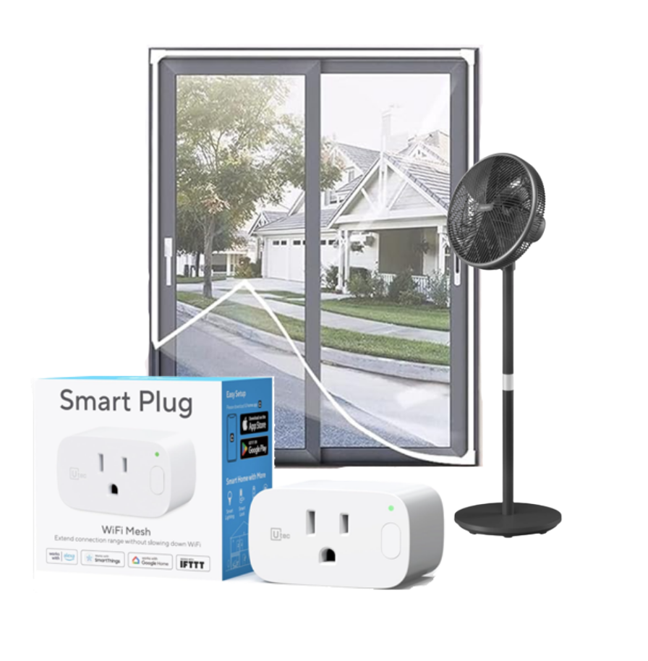
6. Saving energy when renting
Tip: Fans are very cheap to run at 2c per hour, and reduce temperature by 2-3 degrees
Some things you can’t change when you rent but there are still ways to reduce your bills and improve efficiency
Turn off appliances when not in use – this can account for 3% household use
Use draught stoppers to prevent air leaking under doors
Install temporary glazing on windows to insulate (check with landlord before doing this)
Remove frost build up in freezer, improves energy efficiency
Portable fans are the cheapest form of cooling
Better Renting, SYC Rent Right and Housing Safety Authority (HSA) have resources, information and can advocate for renters
Notes:
SPEAKER: Are there any renters? Yes – go through content. If NO – still handy to cover briefly
SPEAKER NOTES:
More than a third of South Australians rent their homes.
There are some things you can’t change when you rent.
There are still ways to reduce your bills and improve efficiency.
Some of the most effective steps involve small changes to your daily habits.
Some have no financial cost to you.
Here’s some specific tips for renters…
The following simple actions could save a household of 4 approximately $650 a year.
If you've got a second fridge that isn’t used much, getting rid of it could save $85 - $250 a year.
Using the clothesline instead of the dryer once a week could save $85 a year.
Installing a water-efficient 3 or 4-star showerhead could save $315 a year on water bills. (WELS3)
You’ll also save on your energy bills because less water will need to be heated.
Other ideas include:
Buying the most efficient appliances possible when you need too – like a fridge, washing machine or dryer. You will take these with you.
Replacing thin curtains with thick curtains
Running low-cost personal heating and cooling items
Using shade cloth or sheets for temporary shading outside the house in summer.
If you plan on staying in the house for a while – consider asking the landlord if you can make changes. For example, install a reverse cycle air conditioner in the lounge, or installing a honeycomb blind or curtain where there wasn’t one.
If you need advice on what you can and can't do, and how to ask for permission, ask your agent/property manager or call Rent Right SA.
Ref: https://www.energy.gov.au/households/household-guides/renters
Ref: https://www.betterrenting.org.au/coping_cookbook

Slide 36
7 – Your take-home action plan
Notes:
7 – Your take-home action plan

Slide 37
7. RECAP – Learning objectives
The main things we wanted you to take away from today:
Understand how energy is used in the home
Learn easy ways to save energy
Know how to heat and cool your home efficiently
Understand how to choose energy-efficient appliances
Notes:
SPEAKER NOTES:
We have covered a lot of information today, a quick recap on the learning objectives:
The main things we want you to take away from today:
Understand how energy is used in the home
Learn easy ways to save energy
Know how to heat and cool your home efficiently
Understand how to choose energy-efficient appliances

Slide 38
Group Activity
5 minutes
7. GROUP ACTIVITY
Reflection on key learnings
Let’s put that new knowledge into action!
Reflecting on what we have covered today:
What is one helpful thing you now know?
Let’s share as group…..
Notes:
SPEAKER NOTES:
Let’s put that new knowledge into action!
ACTIVITY: Reflecting on what we have covered – what is one thing you know now?
Let’s share as a group
SPEAKER TIP: write down all the things on the whiteboard/paper… go around to each person
PROMPT / Suggestions:
Efficiency - reducing use but get the same benefit, rather than conservation - going without to reduce use
Being more energy efficient will cost me less but is also good for the environment
Heating and cooling use the most energy in the home, then appliances
Having good thermal efficiency at home means I will use less energy to keep the home cool and warm
Set A/C temps 24-27 in summer and 18-21 in winter to keep comfortable but save energy
Heat wisely - use curtains, stop draughts under doors
Cool wisely - use fans, close blinds during the day, stop draughts under doors
To keep warm - heat myself with warm clothes, heat bags, oodies, ugg boots
Energy rating - the more stars the more energy efficient
Energy efficient appliance may cost more to purchase but is cheaper to run…
Running costs can be calculated using input power
SA Gov have an appliance running cost calculator
Non-permanent options (good for renters) fans, temporary glazing, draught stoppers, smart plugs that means use electricity at set time periods (when electricity is cheaper)

Slide 39
7. INDIVIDUAL ACTIVITY
Your take-home action plan
Individual Activity
5 minutes
What are two things you are going to do leaving here today…?
Write down your top 2 things on your take-home action plan
Some suggestions:
Set A/C temp 24-27 in summer & 18-21 in winter
Purchase a portable fan
Check appliance information sticker for input power – use calculator for its running cost
Get some draught stoppers for doors
Purchase a heat bag for winter
Use my washing machine and dishwasher during the day when energy is cheaper*
Change my shower-head to an energy efficient 3- or 4-star one
Apply weather seals to windows, skirting boards, skylights and cornices.
Notes:
SPEAKER NOTES:
Let’s put that new knowledge into action!
ACTIVITY:
What are two things you are going to do leaving here today…?
This will be different for each person; we won’t be sharing these. This is for you to take home and try to action.
Using your Take Home Action Plan templates, commit to 2 things you can do when you get home.
Write down your top 2 things on your take-home action plan.
PROMPT / Suggestions:
Set A/C temp 24-27 in summer & 18-21 in winter
Purchase a portable fan
Check appliance information sticker for input power – use calculator for its running cost
Get some draught stoppers for doors
Purchase a heat bag for winter
Use my washing machine and dishwasher during the day when energy is cheaper*
Change my shower-head to an energy efficient 4-star one
Apply weather seals to windows, skirting boards, skylights and cornices.

Slide 40
8 – Next steps
Notes:
8 – Next steps

Slide 41
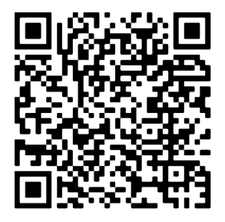
8. Next Steps – Evaluation / Feedback
Evaluation / Feedback process:
Today’s training - complete online feedback form via Energy Literacy Train the Trainer Program | Talking Power
Scan QR Code to take you to Energy Literacy – Train the Trainer program page
Notes:
SPEAKER NOTES:
Thank you for attending this session. We would very much appreciate any feedback you can provide to help us with future sessions.
Scan this QR code to take you to the Energy Literacy – Train the Trainer page on our Talking Power website.
From there you can find our feedback form.

Slide 42

8. Next Steps - Congratulations!
Next steps
Certificate of completion
Running your own community education / outreach session
Register at talkingpower.com.au
All resources and handouts available on Talking Power website’s dedicated Energy Literacy page
Share this training opportunity with colleagues
Scan QR Code to take you to Energy Literacy – Train the Trainer program page
Notes:
SPEAKER NOTES:
Congratulations! This brings us to the end of our Train the Trainer sessions
Please make sure you don’t leave without:
Receiving your Certificate of Completion
Submitting feedback on our sessions
What are your Next Steps?
Perhaps you are interested in running your own community education / outreach session
Register at talkingpower.com.au to follow this project and receive email updates
All resources and handouts available on Talking Power website – dedicated Energy Literacy page
Please share this training opportunity with colleagues

Slide 43
Thank you
Notes:
Thank you

Slide 44
talkingpower.com.au/electricity-literacy-train-trainer-program
SA Power Networks’ Copyright©
This publication and its contents are the property of SA Power Networks and is copyright protected. SA Power Networks reserves to itself all rights in such material. Not part of this publication is to be reproduced or modified without first obtaining the SA Power Networks’ permission, except as permitted under the Copyright Act 1968.
SA Power Networks’ Disclaimer:
The purpose of this document is to provide general information to assist in the understanding of electricity bills;
Unless otherwise agreed in writing between SA Power Networks and a specific person or entity, SA Power Networks makes no representation that this document is appropriate for any other purpose and, to the extent permitted by law, has no liability to a person who (without SA Power Networks written consent) purports to use the standard for any other purpose. SA Power Networks has made no assessment of any nature whether this standard is appropriate for use in any other circumstance than that noted in paragraph 1.
Nothing in paragraph 2 waives or licences any copyright SA Power Networks has in this document.
This document is subject to change from time to time.

