Slide 1
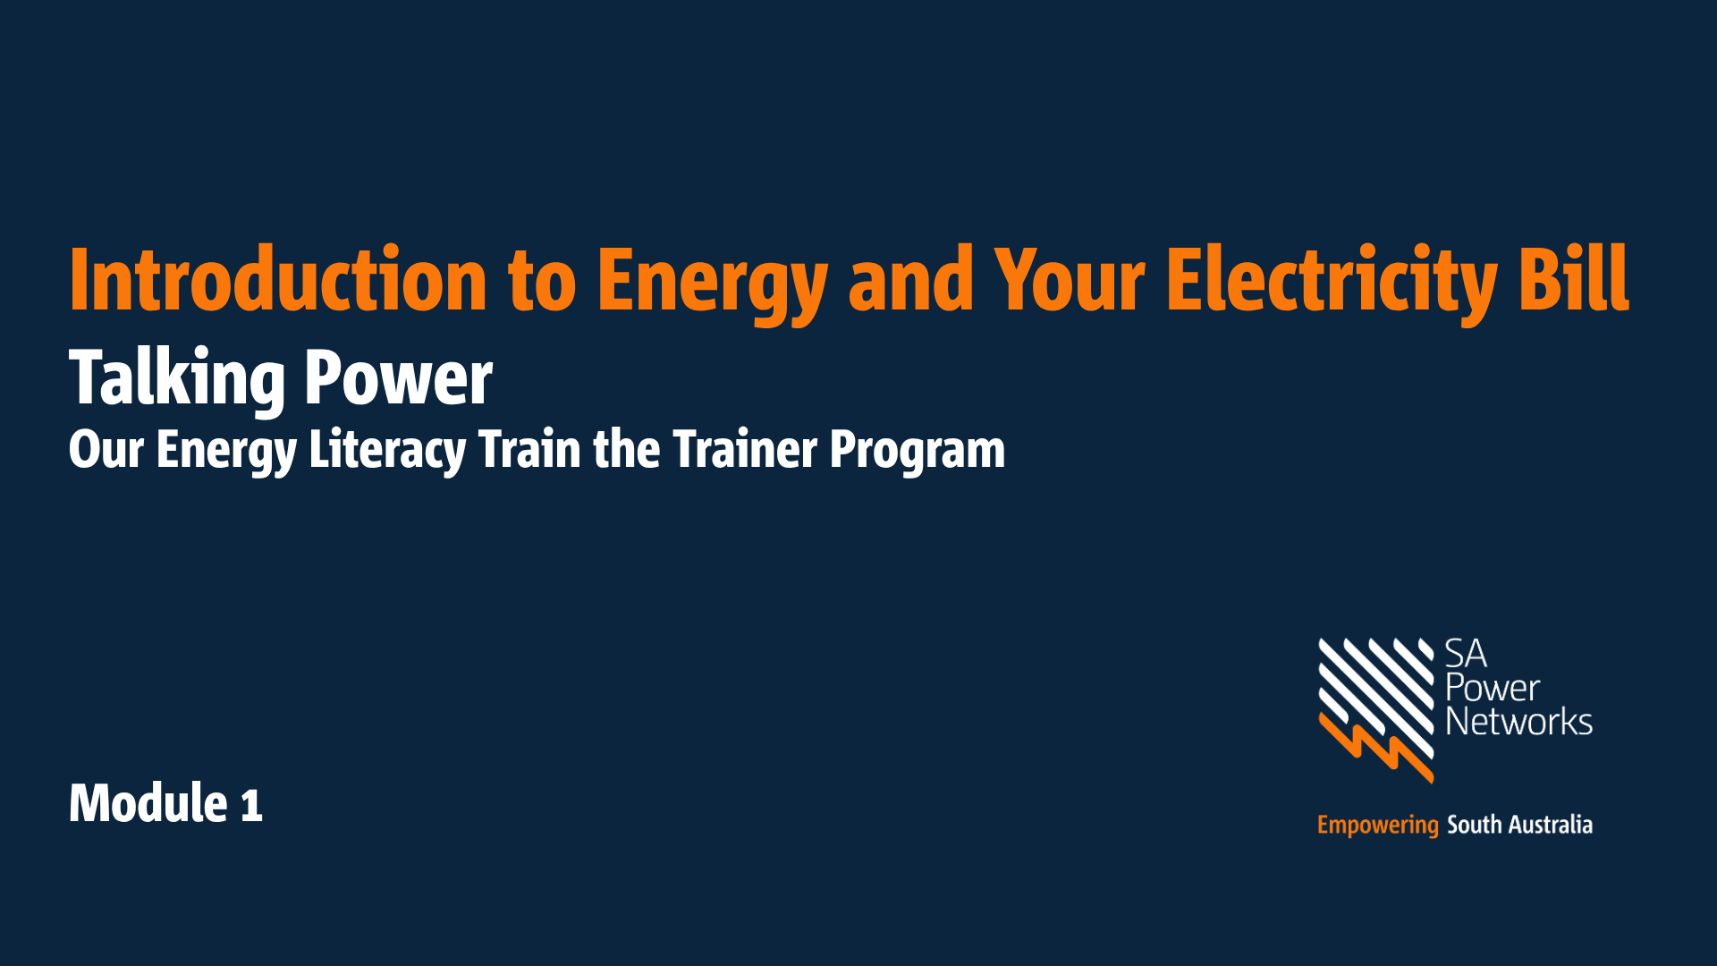

Slide 2

Acknowledgement of Country
SA Power Networks Acknowledges the multiple Traditional Owners of the lands that host the South Australian electricity network and their connections to land, sea, and community.
We would also like to pay our respects to all First Nations’ Peoples past and present and acknowledge these living cultures.
Notes:
SPEAKER NOTES:
We begin today with an Acknowledgement of Country (read through the Acknowledgement as per the slide.)
TIPs:
Add your own Indigenous artwork
Or visit here for First Nations ethical resources that can be used for free Acknowledge Country Posters — KNOW YOUR COUNTRY
PROMPTs:
Can also include the name of the specific Traditional Lands that you’re on, visit here to find out more Whose Country am I on? | AIATSIS
If the session is online and there are attendees on other Traditional Lands, encourage them to put this in the online chat.

Slide 3
Welcome
This is module 1 of our Energy Literacy program:
Module 1 – Introduction to energy and your electricity bill
Module 2 – Saving energy and money
Focus is on simple, easy tips and tricks to remember
Relaxed session, feel free to ask questions!
You will receive a take home guide to help remember key points
Notes:
SPEAKER NOTES:
About the session…
Today is an introduction to energy in your home
It is the first session of two sessions
These sessions look at 1. Introduction to energy and your electricity bill, 2. Saving energy and money
This session should take about 2 hours and there is plenty of time to ask questions
Remember if you have a question, more than likely someone else has the same question so please feel free to ask us if you want to know more.
About me and those that have helped today…
I’m here today from (insert organisation) our role is (insert brief role description)
Introduce any other presenters
Emergency exits
Morning tea and lunch breaks/outline schedule
Housekeeping etc
Go around the room and ask all participants to introduce themselves, where they are from and why they are undertaking this training.

Slide 4
Module 1 - Learning Objectives
The main things we want you to take away from today:
How electricity connects to the house
Who to contact for help, including financial support
How to read your electricity bill
How to get the best energy deal for you
Notes:
SPEAKER NOTES:
There are 4 learning objectives that summarise the main things we would like you to take away from today.
These are:
How electricity connects to the house
Who to contact for help including financial support
How to read your electricity bill
How to get the best energy deal for you
There will be a lot of information but don’t worry – we will give you some take home information to refer back to.
TALKING POWER WEBPAGE
All the materials we use today – from the slide show to the handouts and games – are available on the Talking Power Webpage. You can download them from here.
It is the webpage you registered for the training on.
Ensure you click ‘Follow’ so you get notified of all the updates that get made in the future.
Let’s get started.

Slide 5
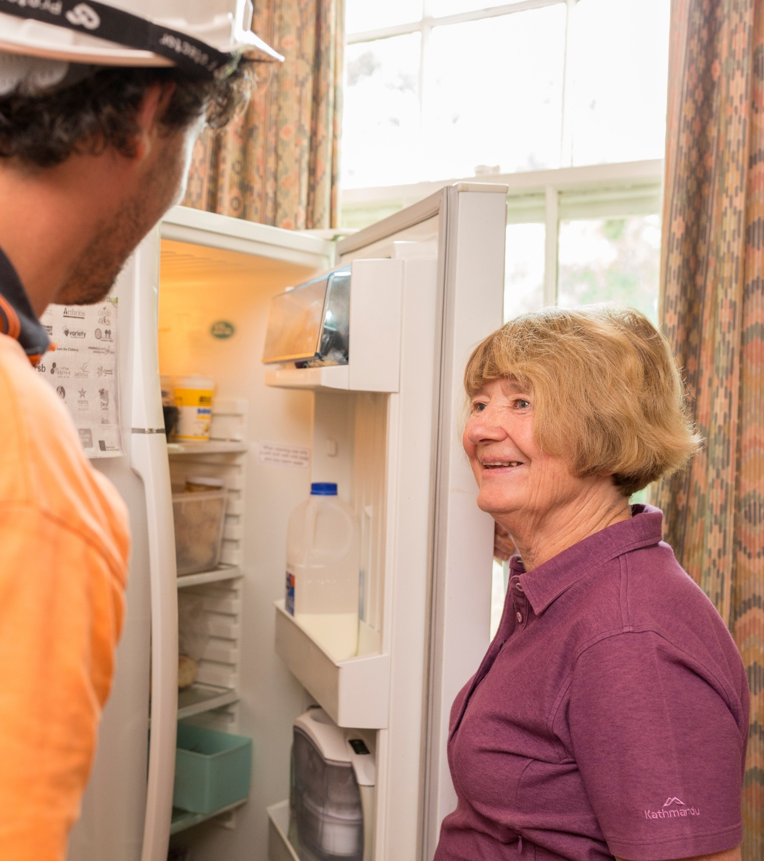
Agenda
Today we will talk about
  Overview of energy in Australia
  How energy gets to your home
    Distributor, Retailer, Energy Services
    Smart meters
  Where to get support
  Your electricity bill
    Usage and charges
    Understanding your bill
  Getting the best deal
  Concessions & rebates
  7. Your take-home action plan
Notes:
SPEAKER NOTES:
Today we will talk about
Overview of energy in Australia
How energy gets to your home
Distributor, Retailer, Energy Services
Smart meters
Where to get support
Your electricity bill
Usage and charges
Understanding your bill
Getting the best deal
Concessions & rebates
Your take-home action plan
We want to make this training relevant to you – so at the end we hope everyone will have 2 things to put down on their ‘take home action plan’ from today’s session

Slide 6

Introductions
Activity option 1
12 minutes
Let’s go around the room and introduce yourself
ACTIVITY
Your energy
“Have you ever had a surprising electricity bill, found a good energy deal, OR had a time when you needed help?
Break into pairs
For the next 3 minutes, share your experience with your partner
We will come back as a group and invite volunteers to share
Notes:
SPEAKER NOTES:
Go around the room and ask people to introduce themselves
ACTIVITY OPTION 1:
Start with a short activity to get people comfortable and thinking about energy
Break into pairs
For the next 3mins, share your experience with your partner
We will come back as a group and invite volunteers to share
TIPs:
Open up for sharing – write down on note paper / whiteboard, what are the common themes?
Hopefully we can address these today.

Slide 7
Introductions
Activity option 2
10 minutes
ACTIVITY
Your energy bill
“How do you feel when you get your latest electricity or gas bill?”
Review the picture cards
Pick the top 1 or 2 emotions that immediately come to you.
We will come back together and discuss as a group
Notes:
SPEAKER NOTES:
ACTIVITY OPTION 2:
Start with a short activity to get people comfortable and thinking about energy
We have cards laid out on table (stack of each option)
“Think about how you use energy in your life/home, pick the 3 top three things you value in your energy use the most”
Pick 3, then we discuss in a group
Are there common themes? Are they all different?
TIPs:
Open up for sharing – write down on note paper / whiteboard, what are the common themes?
Hopefully we can address these today.

Slide 8
1 – Overview of energy in Australia
Notes:
1 – Overview of energy in Australia

Slide 9
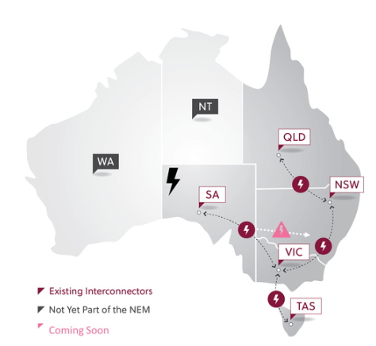
1. Energy in Australia
The National Electricity Market (NEM)
The National Electricity Market (NEM) is one of the world’s longest interconnected power systems
Made up of about 40,000 km of transmission lines and cables, which transport electricity to more than 85% of Australia’s population
Covers SA, VIC, NSW, ACT, QLD and TAS
The Australian Energy Market Operator (AEMO) operates the NEM.
www.aemo.com.au
Notes:
SPEAKER NOTES:
The National Electricity Market (NEM) is on Australia’s eastern and south-eastern coasts, stretching approximately 5,000 kilometres.
It includes five interconnected states: Queensland, New South Wales (including the Australian Capital Territory), South Australia, Victoria, and Tasmania.
You can see from this picture just how big the power system is.
PROMPTS:
What do you think, did you know it was this big? Did you know it was all connected?
SPEAKER NOTES continued:
Western Australia and the Northern Territory are not connected to the NEM, mostly due to the large distances between the west and east of Australia.
The Australian Government, through the Australian Energy Market Operator (or AEMO), is responsible for looking after how electricity is used across the states and the flow of energy across the power system.
Today we are looking at how energy gets to your home and what this means for you.

Slide 10
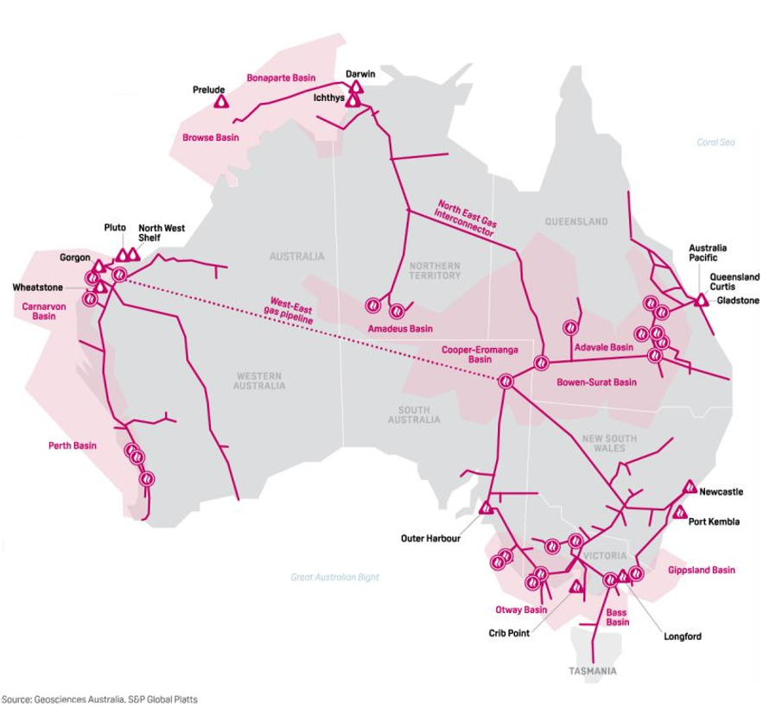
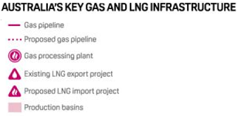
1. Gas in Australia
Australia’s first gas pipeline in 1800s was 10x longer than any other in the world at the time
Approximately 42,000km of natural gas transmission pipelines across Australia
What gas appliances are used in a house?
Notes:
SPEAKER NOTES:
Australia has around 42,000km of natural gas transmission pipelines that transport gas under high pressure from where it is produced to the outskirts of cities both large and small.
Australia’s first pipeline was commissioned in the late 1800s to transport water to the Coolgardie gold fields in Western Australia. This set a worldwide precedent by being more than 10 times longer than any other existing pipeline.
It includes five interconnected states: Queensland, New South Wales (including the Australian Capital Territory), South Australia, Victoria, and Tasmania.
This training package is designed to focus mostly on electricity. We will not mention gas very much.
PROMPTS/Questions:
How many people here have gas in the home?
What gas appliances are commonly used in a house?
Hot water systems, indoor heating and indoor cooking.
BBQs are also used in homes but usually on bottled gas

Slide 11
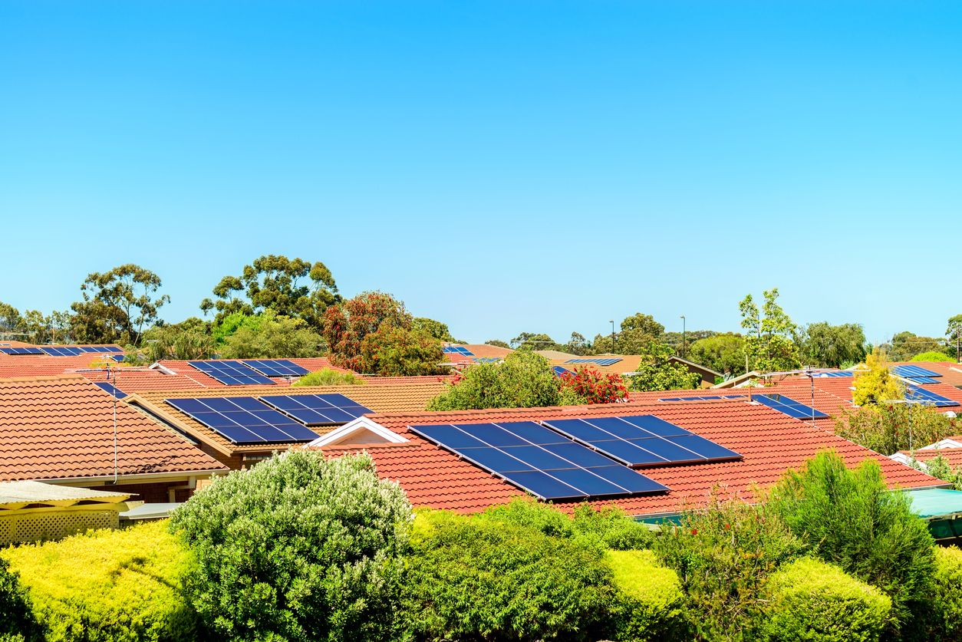
1. Renewables in Australia
Renewable energy like solar (sun), wind and hydro (water) is growing in Australia and supplies an increasing amount of electricity to homes and businesses.
Renewable energy provided 40% of Australia’s total electricity generation in 2024 (up from 39.4% in 2023)
Wind is the single-largest sector, at 13.4%, followed by rooftop solar, at 11.2%
South Australia
Leads the way in renewable energy
Nearly 50% of homes have rooftop solar
We generate more than 70% of electricity from renewable sources
By 2025/2026, the goal is 85%, with a target of 100% net renewable energy by 2027.
Notes:
SPEAKER NOTES:
Read the top text and dot points
Over time, Australia is moving away from dirty energy sources like gas and coal and towards clean renewable energy. This will reduce the amount of carbon released into the atmosphere, to limit and positively contribute to climate change efforts. This is to protect the planet and ensure a sustainable future. Renewable energy (sometimes called green energy) uses natural resources that are constantly replaced and never run out.
Just as there are many natural sources of energy, there are many renewable energy technologies.
Solar is one of the most well known; this includes solar panels on rooftop houses.
Wind power is most widespread, and hydropower is one of the oldest.
In 2024, renewable energy accounted for 40 per cent of Australia's total electricity.
That figure has more than doubled since 2017.
Every state and territory are working towards 100% renewable energy.
Clean Energy Australia 2025 report | Clean Energy Council (2025 Report published late May 2025 – 2026 report should be released soon)

Slide 12
2. How energy gets to your home
Understanding the Distributor, Retailer and Energy Services
Notes:
2. How energy gets to your home: Understanding the Distributor, Retailer and Energy Services

Slide 13
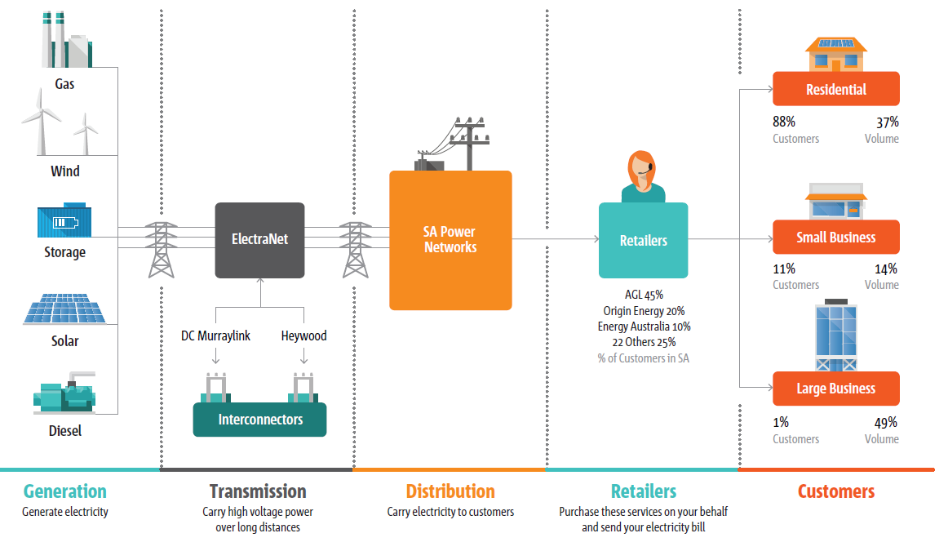
2. Understanding the Distributor, Retailer and Energy Services
Notes:
SPEAKER NOTES:
Generation: Gas, wind, solar – creation of electricity
Transmission: ElectraNet in SA – carries electricity long distances (interconnectors between the states)
Distribution: SA Power Networks – the poles and wires to homes and business across South Australia
Retailers: Bills customers for the costs of getting electricity to their home or business.
*Retailers now own meters
They sell you energy. Their logo is on your bill.
Your meter is your retailer’s connection to you and to know how much electricity you use or send back to the grid.
Your home: you are an energy consumer
Some homes are also small-scale electricity generators with solar panels and batteries.

Slide 14
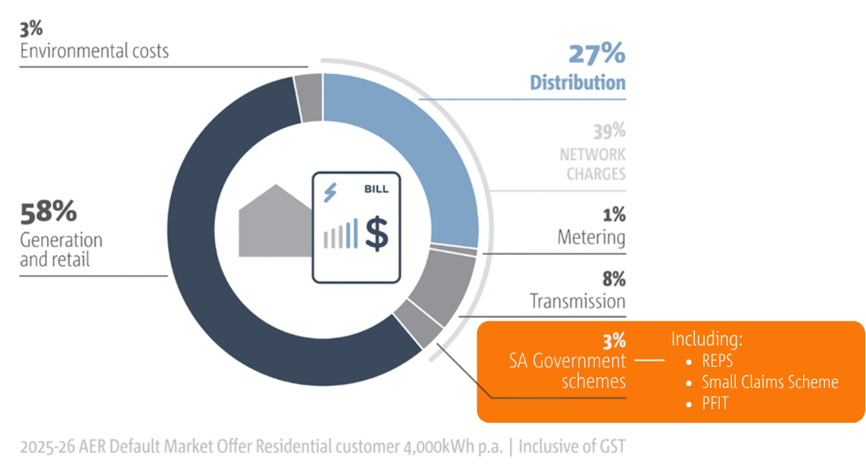
2. Understanding the Distributor, Retailer and Energy Services
Notes:
SPEAKER NOTES:
Electricity bill breakdown: Go through pie and talk about different components that make up 100%
Transmission and Distribution costs are set for 5 years (Regulated amounts)
Generation and retail costs can fluctuate (supply and demand)
PROMPT:
Discuss how REPS, the distributor Feed in Tariff (0.44c until 2028) and SA Power Networks Small Claims Scheme are included in Green Schemes.
These schemes benefit some, if eligible, and are paid for by everybody.

Slide 15
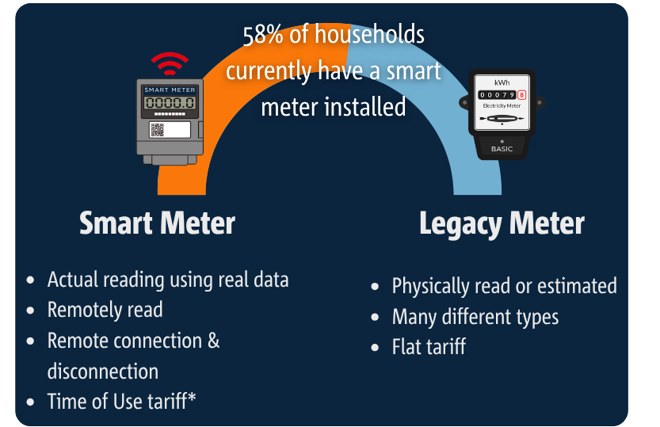
2. Your meter
Meters count how much electricity (kWh) or gas (MJ) a home has used. Retailers then know how much to charge you.
SA is currently undergoing a ‘smart meter roll out’.
Smart meters:
Don’t need to be physically read
Send regular electricity usage data to the cloud
Can provide energy users with real time data, allowing people to understand their energy use and make changes as they need to
Will lead to less estimated reads, more accurate bills
Accelerated roll out by 2030.
Access your energy data:
Retailer app (not all have them)
SA Power Networks ‘Your Meter Data’
58% current as of April 2026
Notes:
SPEAKER NOTES:
Let’s have a look at meters now.
What are meters?
Meters count how much electricity or gas a home has used so that retailers know how much to charge on your bill.
You can see the numbers here on the image, that’s the meter counting how much power you have used.
Meters are located outside your home, usually in a place that someone can access them; they are often protected in boxes called meter boxes.
If you have a problem with your meter, you can contact your retailer to help you.
Smart meters
Since December 2017 in Australia, all new meters must be ‘smart meters’.
Smart meters can send and receive energy information about your home directly to your retailer using the internet.
That means a person does not have to come out to read your meter.
If you don’t have a smart meter, then someone will need to access your meter to read it.
What are the benefits of having a smart meter?
It helps retailers calculate your bill accurately, instead of relying on meter reads
Customers can choose to access a wider variety of services, such as in-home displays, to help better manage electricity use and costs
It makes it simpler and easier to identify if a meter has stopped working and needs to be repaired
It can help your distributor (the business who looks after power poles, wires and gas pipelines) understand how power gets to your home and also when the power goes out.
Do I have to get a smart meter?
Yes, you do. The smart meter roll out was accelerated in 2025.
If you don’t want a smart meter, you can no longer say no.
If there is something wrong with your meter and you need a new one, a smart meter will be installed.
Can I ask to get a smart meter?
You can ask your retailer when they will install a smart meter at your address if you don’t already have one.
Your retailer will arrange this with you.
After you get a smart meter & tariffs
For two years after the installation of a smart meter, your retailer must get your explicit informed consent before switching you to another tariff. Retailers will also be required to offer you a flat/fixed tariff (as well as a Time of Use tariff), if you would prefer that option.
ref: Metering | AEMC and image from: Smart meters: How they work | CHOICE
https://www.sapowernetworks.com.au/your-power/smarter-energy/national-smart-meter-rollout/
https://www.aer.gov.au/consumers/smart-meter-rollout/consumer-rights-and-smart-meters
https://www.energymining.sa.gov.au/consumers/power-usage-savings-and-efficiency/national-smart-meter-rollout/post-installation-and-ongoing-use

Slide 16









2. Who can help with energy in the home?
Retailer
Your energy retailer is who sells you energy - their logo and contact details are on your bill
Your retailer:
Owns your meter
Sends you your electricity bill
Help if you are finding it hard to pay your bill “I am in financial hardship; Can I speak to your hardship team?”
Help with payment extensions, payment plans
Advice on how to change/lower energy use
Notes:
SPEAKER NOTES:
There are several services that can help you with energy in your home.
Your energy retailer who sells you energy, are businesses like Energy Australia, Origin, AGL, Lumo, GloBird and 20 others operating in SA right now (25 total)
Contact your energy retailer first for help on your bill or energy service.
Energy retailers are required to help you if you’re finding it hard to pay your bill.
Asking for help as early as possible means you can avoid extra fees or disconnection.
Retailers can help with payment extensions, setting up payment plans, concession information, and putting you in contact with other help such as a financial counselling service.
They are required to tell you about your right to complain if you have problems with your energy service
Energy retailers must also provide extra rights for customers affected by family violence.
Note: You are not required to provide proof that you are affected by family violence.
Key points for those experiencing financial hardship or vulnerability:
If you’re unable to pay your bill on time or have difficulty paying a bill in the past, contact your retailer immediately to discuss how they can help you
They are required to provide you with flexible payment options
They are required to have a Hardship Policy in place.
Hardship agreements must consider:
your ability to pay
debt you owe to the retailer
your expected energy needs over the next 12 months.
Your retailer can’t disconnect your energy supply if you're making the agreed payments. But if you don't, the hardship plan could be cancelled and your service disconnected.

Slide 17

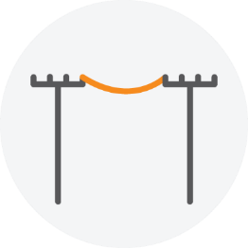


2. Who can help with energy in the home?
Distributor
Your energy distributor gets energy to your home using power lines, stobie poles, and pipelines that carry electricity and gas.
Your distributor:
Undertake planned maintenance work on power lines (or gas pipes)
Restore power during outages
Communicate outages
Emergency and storm response
Shocks and tingles – contact SAPN for safety
Smelling gas leaks, report an outage to AGN
Notes:
SPEAKER NOTES:
There are several services that can help you with energy in your home.
Your electricity distributor, who gets electricity to your home, is SA Power Networks
For gas, it is Australian Gas Networks
Your electricity and gas distributor can help you with concerns (like safety concerns) about power lines, power poles, and gas pipelines in your community.
Your distributor helps with electricity or gas outages.
Gas distributors also look after gas meters including gas meter reading.
Your energy distributors’ contact details are on your relevant bill.
HIGHLIGHT
Australian Gas Networks has a hardship program called Priority Services
https://www.australiangasnetworks.com.au/priority-service
Priority Services may include gas appliance safety checks, emergency repairs to gas hot water services, gas heaters, gas cookers and gas ovens, and for eligible customers outside of Victoria, rebates to help you replace broken or unsafe appliances. If you, or someone living with you, are experiencing vulnerability you could be eligible for Priority Services.

Slide 18



2. Do you live in a retirement village, apartment or caravan park?
Energy to your home is called an embedded network, because the owner sells energy to you that they buy from an energy retailer.
You are a customer protected by Australian law.
Notes:
SPEAKER NOTES:
Do you live in a retirement village, apartment block, or caravan park, or perhaps own a business in a shopping centre?
In some homes like apartment blocks, retirement villages, caravan parks and sometimes even shopping centres, it is the owner of the building or site who sells energy to all the tenants and residents.
This is known as an embedded network.
The owner usually buys energy from an authorised energy retailer and then ‘on sells’ the energy to tenants and residents.
If you buy energy from an owner this way, you are still protected by Australian law.
Your rights by law will include:
Flexible payment options if you are having problems paying your bills
Clear and set time frames for receiving and paying bills
Complaints handling arrangements
Energy prices that are no higher than prices that a local energy retailer can charge
Clear and reasonable disconnection procedures
ref: www.aer.gov.au/consumers/understanding-energy/embedded-networks-customers
EWOSA fact sheet: https://ewosa.com.au/assets/volumes/general-downloads/fact-sheets/Embedded-networks.pdf

Slide 19

2. RECAP – How energy gets to your home
South Australia is leading the nation in the renewable energy transition.
We are also undergoing a massive change in household energy – with smart meters to be installed on most homes by 2030. New tariff (or pricing) structures are also available.
Your energy distributor can help you in an emergency and is your contact for safety concerns.
Your energy retailer is your contact for questions about energy supply, metering and are legally required to support you if you are unable to pay your bill on time.
Notes:
SPEAKER NOTES:
Let's recap what we’ve learned about how energy gets to your home:
South Australia is leading the nation in the renewable energy transition.
We are also undergoing a massive change in household energy – with smart meters to be installed on most homes by 2030. New tariff (or pricing) structures are also available.
Your energy distributor can help you in an emergency and is your contact for safety concerns.
Your energy retailer is your contact for questions about energy supply, metering and are legally required to support you if you are unable to pay your bill on time.

Slide 20
3. Where to get support
Notes:
3. Where to get support

Slide 21
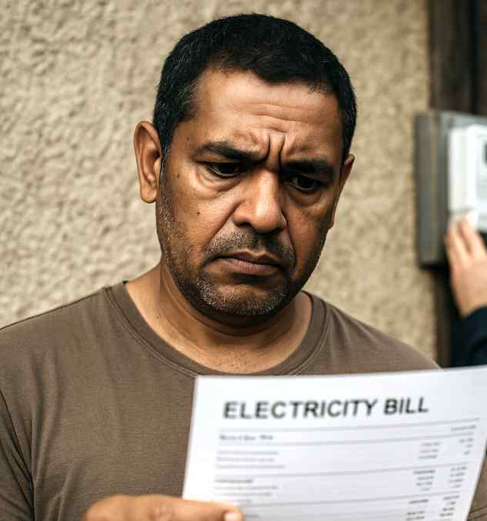
3. Where to get support
Support is available for:
Financial
E.g. debt, hardship, bill payment issues
Energy advice
E.g. energy efficiency, information
Other disputes
E.g. meter readings and charge discrepancies to Ombudsman
Notes:
SPEAKER notes:
There are other support services that can help you if you need more help and information.
All the options I will speak about are totally FREE
Financial support if you need help with debt, hardship, or bill payment issues.
Energy advice – if you would like information on how to be more energy efficient or purchasing an energy efficient appliance.
Dispute resolutions services via Energy and Water Ombudsman of SA (EWOSA) – if you can’t resolve an issue with your retailer. EWOSA can also help direct you towards someone who can help, if your matter is not a complaint.

Slide 22

3. Who can help with your energy concerns and bills?
Contact your energy retailer about issues or concerns first, including billing queries, request for payment plans or extensions.
If you are unhappy with the support or feedback from your energy retailer, you can contact the Energy and Water Ombudsman of SA (EWOSA).
The energy Ombudsman is an independent and free service for energy customers who need help sorting out a problem, with their energy retailer.
Tip: Did you know that EWOSA is a free service to help with energy complaints if you are not successful in solving your issue with your retailer?
Phone: 1800 665 565
SMS: 0488 854 555
Web: www.ewosa.com.au (fact sheets and live chat)
Notes:
SPEAKER NOTES
Every state or territory has an energy ombudsman.
Yours is EWOSA – Energy and Water Ombudsman of SA
An energy ombudsman is an independent and free service for energy customers who need help sorting out a problem, also known as a dispute, with their energy retailer.
If there’s a problem:
Firstly, contact your energy retailer.
Explain the problem and the solution you want.
If you can’t sort out the problem straight away, ask to speak with a manager.
Keep a record of the date and time of the call, who you spoke to and what you discussed.
If you still can’t resolve the problem, contact your state or territory energy ombudsman.
The energy ombudsman for your area will be on your bill, we’ll show you this later.

Slide 23

3. Who can help with your energy and other bills?
Financial counsellors are qualified professionals who provide information, advice and advocacy to people in financial difficulty
Their services are non-judgmental, free, independent and confidential
Financial counsellors are based in community organisations throughout Australia, from large charities to smaller community centres, as well as local government agencies
Meetings can be over the phone, video call or face to face.
Call 9.30am - 4.30pm
Live chat with a financial counsellor or find self help fact sheets at www.ndh.org.au
Notes:
SPEAKER NOTES:
You can also contact the National Debt Hotline to connect with a financial counsellor, if you would like more information about managing your bills and other household finances.
If you’re feeling overwhelmed and need some help to deal with your finances, you can contact a financial counsellor.
Financial counsellors offer free, confidential and independent help and are considerate and sensitive to your circumstances.
To speak to a financial counsellor, you can:
Call the National Debt Helpline on 1800 007 007 Monday to Friday from 9:30am to 4:30pm.
In the rest of Australia, you will speak to a financial counsellor on the phone, but in SA you'll speak with someone who will direct you to the website for self-help information, or book you in to see a financial counsellor close to you.
If you use the live chat function, you will be chatting with a financial counsellor.
Live Chat
You can use their live chat service by clicking the chat icon in the bottom right corner of your screen at www.ndh.org.au.
Live chat is available Monday to Friday 9:00am to 8.00pm. If you send a message outside these hours a financial counsellor will get back to you.
Self-help
You can make an appointment to see a financial counsellor in your local area through www.ndh.org.au
You can go to www.safce.org.au to find a financial counsellor map
SPEAKER TIP:
You will be able to have all this information in the Fact Sheet from this session.

Slide 24

3. Who can help with your energy concerns and bills?
Free, independent energy information from the SA Government Energy Advisory Service
  help saving energy at home
  understanding your energy bills and meters
  how to calculate appliance running costs & understand where its being used
  links to services that can help with paying bills
  energy efficient homes
  home solar and battery energy
Phone: 8204 1888 or 1800 671 907 (free call from fixed lines)
Monday to Friday, between 9:00 am - 4:30 pm
Email: energyadvice@sa.gov.au
Web: energyadvice.sa.gov.au
Notes:
SPEAKER NOTES
SA has a Department of Energy and Mining group called Energy Advisory Service.
They are a FREE service designed to … READ OUT DOT POINTS.
Energy Advisory Service can support you in your outreach or community education work by
Supporting you to provide information to community groups
Provide free handouts and publications
Provide resources to borrow, like pull-up banners and the Energy Toolkit
Attending events, conferences and other outreach (with enough notice)
Support clients with their energy retailer or others – as a third-party support provider (if it fits within a scope) - reach out to tell them what you want need

Slide 25
RECAP - Where to get support
There are three forms of free external support services for energy advice, disputes and bill help available to people in SA.
  Energy & Water Ombudsman SA (EWOSA)
  Financial Counsellors, Capability Workers or the National Debt Helpline
  Energy Advisory Service
Do you know of anymore?
Notes:
SPEAKER NOTES:
Let's recap what we’ve learned about where to get support:
There are three forms of free external support services for energy advice, disputes and bill help available to people in SA. We have just discussed the different roles and areas of focus they each have, to support you and your clients.
Energy & Water Ombudsman SA (EWOSA)
Financial Counsellors or the National Debt Helpline
Energy Advisory Service
PROMPT:
Group discussion opportunity
Have you encountered any other form of support in South Australia?
Have you seen good examples of support for energy issues, disputes or advice elsewhere?
Has there been a time when you haven’t found the support you were after? What happened? Was it resolved?

Slide 26
4. Your electricity bill
Notes:
4. Your electricity bill

Slide 27
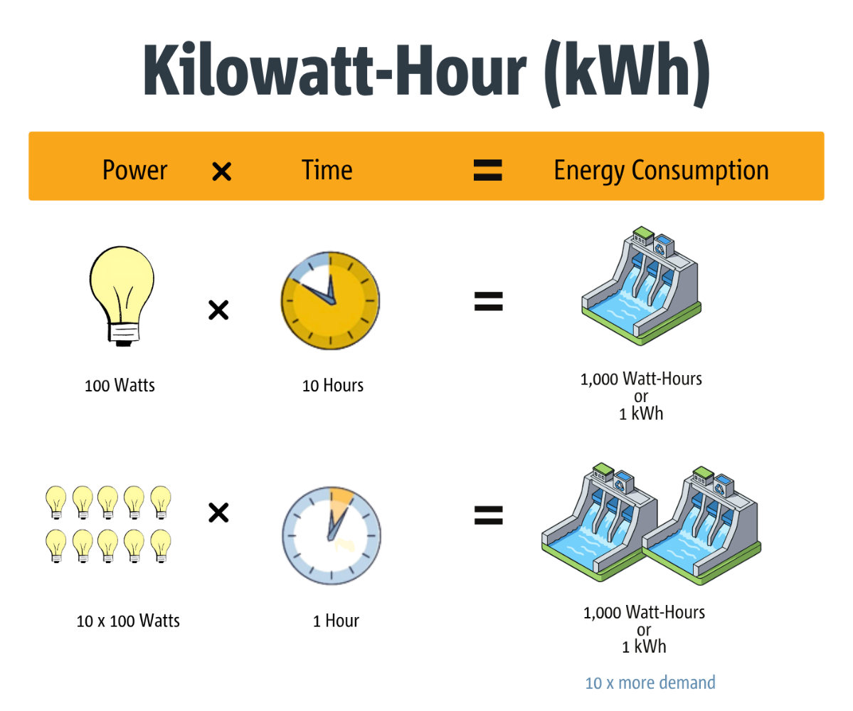

4. Kilowatts (kw) and kilowatt hours
Notes:
SPEAKER NOTES:
Before we start with looking at a bill, we need to know what an energy bill is charging you for.
Energy is measured in kilowatt hours. The charge on the bill is for the total amount of kilowatt hours consumed in a period of time by a household (i.e. 1 month/30 days, or 3 months/90 days).
Appliances are measured by how much energy they could consume per hour – a halogen light bulb in this example is 100watts.
Left on for 10 hours (x10), it can use up to 1, 000 watt hours
1,000 watts is otherwise known at 1 kilowatt/kw – a kw is the unit of measurement for charging electricity.
VIDEO: Let’s watch a quick video that explains kilowatts and kilowatt hours
video link if needed: https://youtu.be/-yBPC77zukc?si=KEqWxK0kCdElymGf

Slide 28
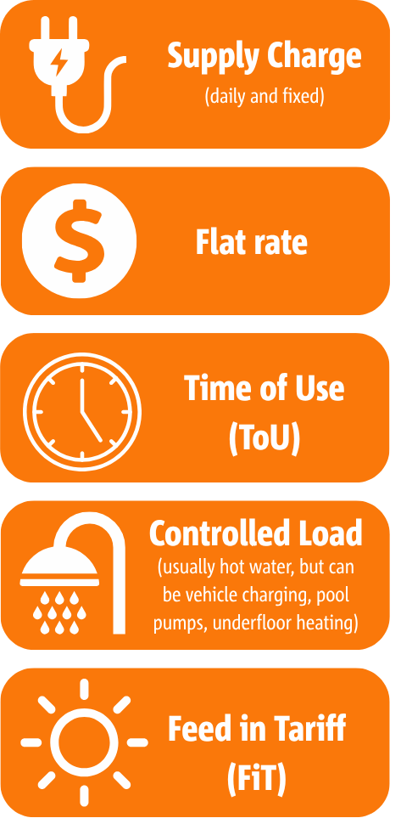
4. Usage and Supply Charges
A charge for supplying electricity to your home, i.e. $1 per day
Same cost for electricity used over a 24-hour period, across the year, i.e. 43c/kWh
A different cost for electricity used at different times of the day,
i.e. 12c 10am-4pm, 22c 1am-6am, 45c 6-10am/4pm-12am
A lower price to run energy-hungry appliances overnight, usually 11pm-7am. NOTE: changing now with ToU tariff
A credit you receive for generating solar energy and feeding it into the energy grid, i.e. 0-44c/kwh
Notes:
SPEAKER NOTES:
Not all electricity is charged to each house or business in the same way. Let’s go through the different type of charges for electricity use.
Daily supply charge: This is the money you pay each day to get electricity and gas at your house or business. The daily supply charge is a fixed charge. This means it is the same on each bill. It is not based on how much energy you use.
Usage charges: Usage charges are the money you pay for the electricity or gas you use.
Electricity is charged as cents per kilowatt hour or c/kWh.
Gas is charged as cents per megajoule or c/MJ.
In South Australia the types of usage charges are:
Single (flat) rate, or Time of Use rate (ToU), for the power you use to run your house (fridge, TV, aircon)
Some houses also have a controlled load meter/charge for eligible electric hot water systems (and some other appliances). This will be a different line to the charges listed above in your bill.
You may receive a bill credit for a:
Feed in tariff (for sending solar energy back to the grid)

Slide 29
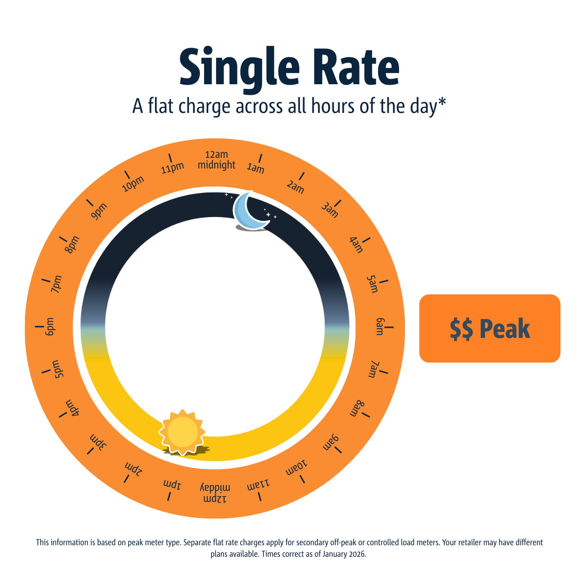
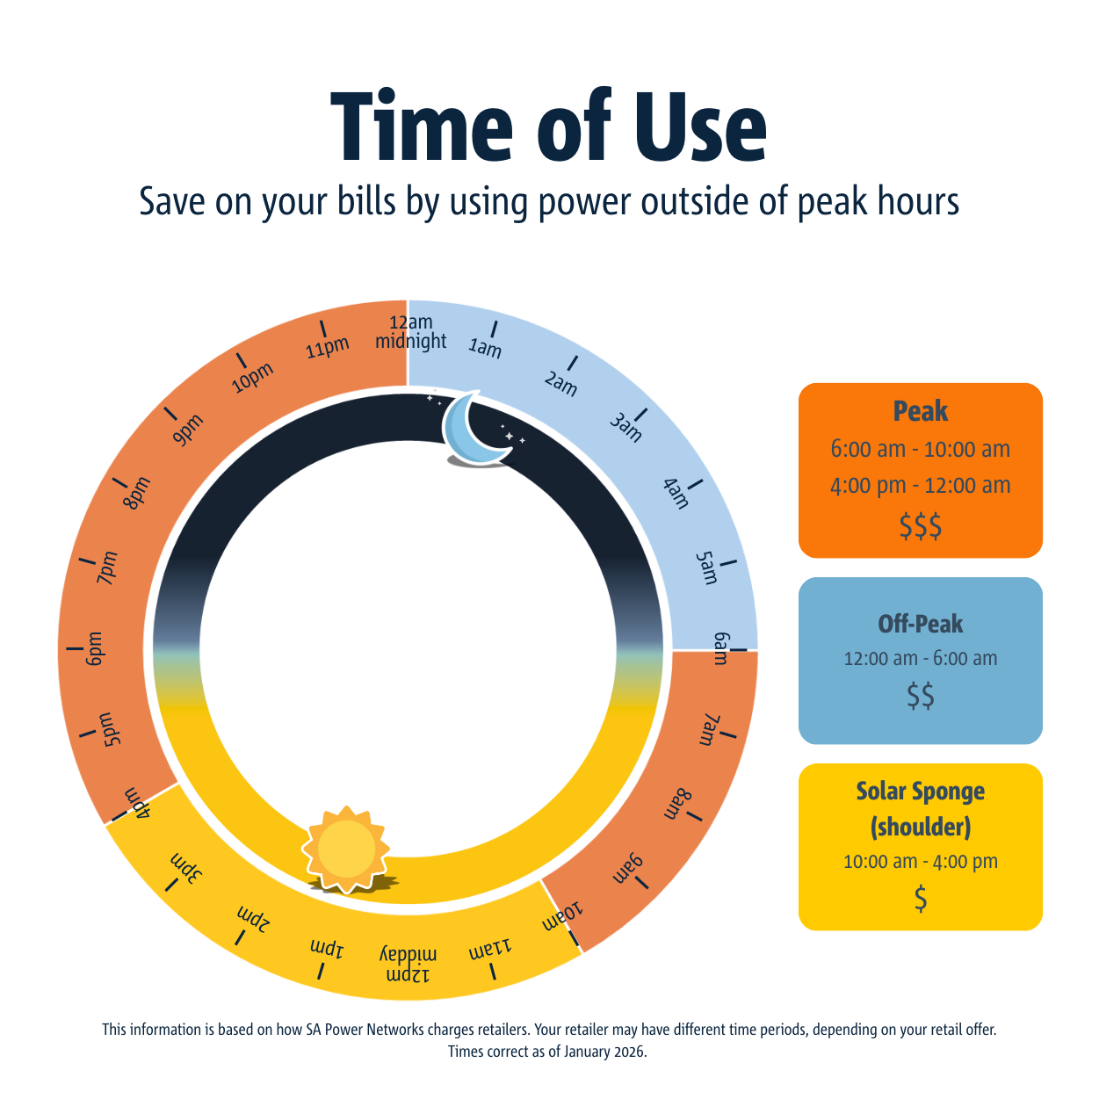
4. Usage and Supply Charges
Notes:
SPEAKER NOTES:
Single Rate and Time of Use (ToU) Rate are tariffs charged depending on the type of meter you have at your house
HANDOUT
Time of use magnet
DISCUSSION PROMPT:
Discuss the different price periods on a Time of Use rate (ToU)
Clarify that a ToU rate only comes with a smart meter and now you can opt out from a ToU plan in the first 2 years of having a smart meter
Discuss as a group the cheapest time to
Wash your clothes
Run the clothes dryer

Slide 30
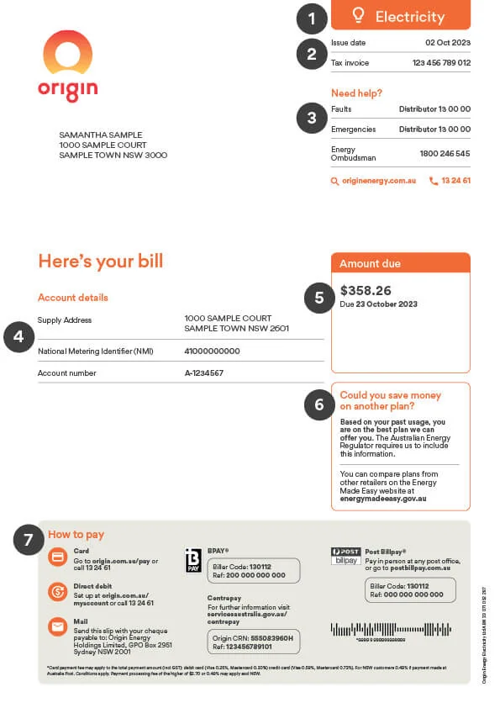
4. Your Bill
Fuel type – electricity or gas
Date the bill was issued
Contacts details for faults and emergencies and the Ombudsman contact details.
Address, NMI for electricity, account number
Amount due and date due
A statement telling you if you could save money on a different plan with that retailer
Different ways to pay
21100000000
Notes:
SPEAKER NOTES:
There is a lot of information on your electricity bill, which is useful but can be overwhelming. Retailers are required to put certain information on the electricity bill, as set out in A Better Billing Guideline – but they can still look a bit different depending on the retailer.
NOTE: The bill layout may change from time to time, after lots of consultation, to better suit the needs of energy customers. The current layout was approved for use in 2023.
Different retailers may lay out the information in slightly different ways, but will have all the information listed below on their energy bills
SPEAKER NOTES:
Using the Origin energy bill as an example, lets look at these features.
Fuel type – electricity of gas
Date the bill was issued
Contacts details for faults and emergencies, and the Ombudsman contact details (as discussed)
Address, NMI for electricity, account number (NMI is number for the meter at your house (use your NMI as reference point for many other tools and resources explained later)
Amount due and date due
A statement telling you if you could save money on a different plan with that retailer (Retailers must show this every 3 months. We will show you coming up in section next steps for comparing)
Different ways to pay. There are many ways to pay that best suit your circumstances.
Some differences or discrepancies might be:
The person who is the ‘account holder’ may not be you; it could be someone else in your household.
The address where the power is going to; this may be different to the postal address on the bill
(ref: Consumer fact sheets | Australian Energy Regulator (AER) and AER - Better Bills - Illustrative example bill - Paginated.pdf)

Slide 31
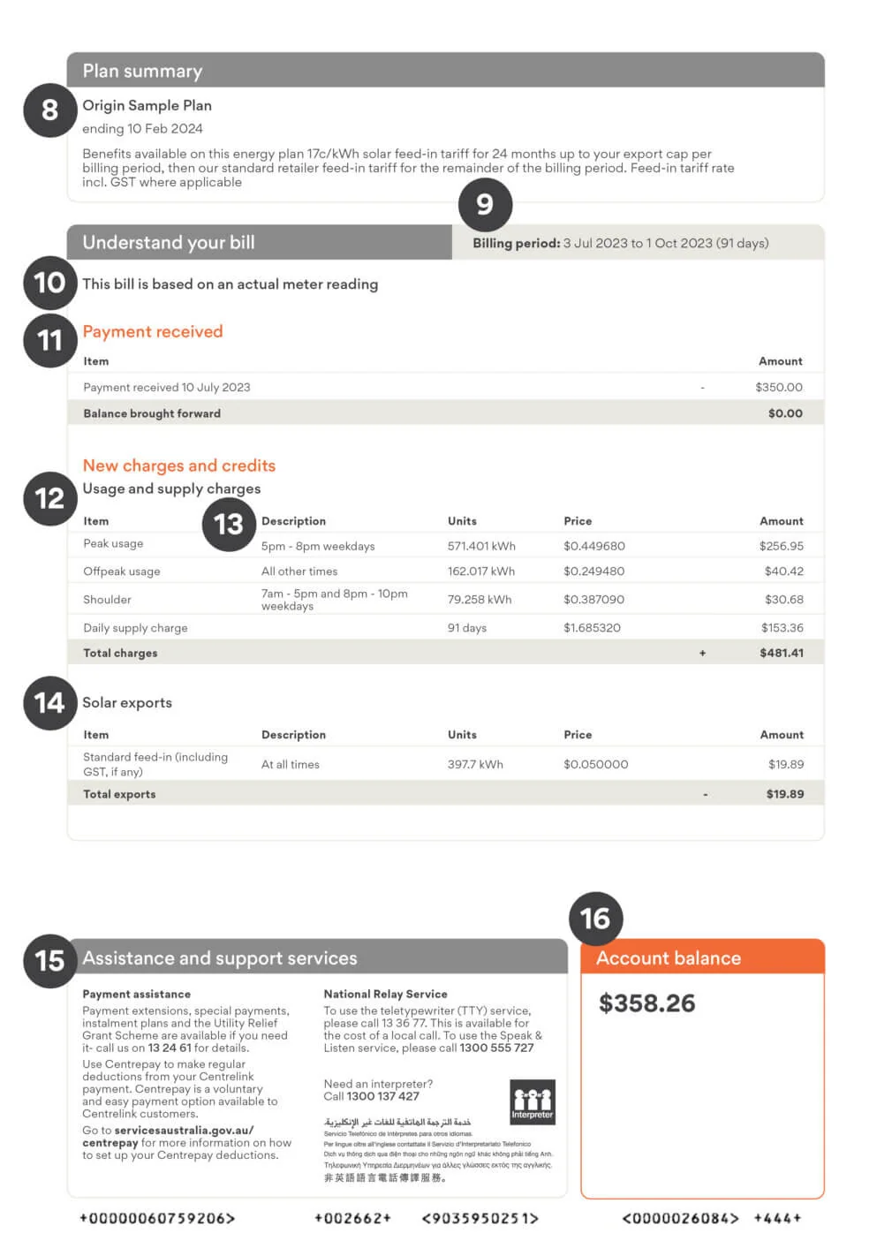
4. Your Bill
Name of the current plan you’re on, when it ends etc.
Timeframe for the bill
Actual or estimated read
Payments received since the last bill was issued
Usage and charges by type
Description of the usage type
Solar credits
Getting help – payment assistance
Account balance
Notes:
SPEAKER NOTES:
Name of the current plan you’re on, when it ends, and any renewable sources, carbon offsets and benefits
Timeframe for the current bill (it’s usually 30 day/1 month or 90 days/3 months)
Actual or estimated read (usually an actual read with a smart meter, can be estimated with an older legacy meter)
Payments received since the last bill was issued
Usage and charges by tariff type (This list can be confusing and complex and links back to the charges we spoke about a couple of slides ago. Take time to understand them. Sometimes it’s good to print out a copy and write over it and make notes.)
- Controlled load sometime is called by another name: J tariff, ancillary – it might not be obvious at first
- Time of use tariff charges and times may very between retailers
Description of the tariff (as above)
Solar credits (cents per kwh is the money the account earns by selling energy back to the grid. Some homes are still receiving a DFiT – distributor feed in tariff of 44c or more. This will finish in mid 2028. Many houses however are earning between 1.5-10c/kwh now.
Getting help (this is the help you can seek from the retailer if you are having trouble paying your energy bill. Call ASAP once you know you can't make the payment due date, to prevent extra fees or electricity disconnection)
Account balance (what is owing).
(ref: Consumer fact sheets | Australian Energy Regulator (AER) and AER - Better Bills - Illustrative example bill - Paginated.pdf)

Slide 32
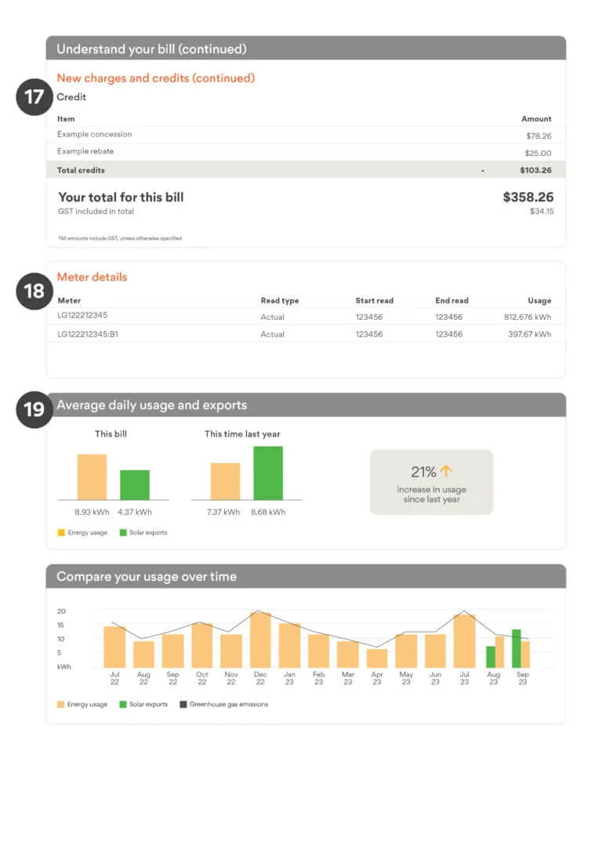
4. Your Bill
Credit, concessions and rebates
Meter reading information
Compare your usage
Notes:
SPEAKER NOTES:
Credits, concessions and rebates: These will be linked to any Government concessions you get, FiT, pay on time discounts or credits from adjusted bills in the last period.
A meter reading for the meters at the house. There can be more than one line, even if the meter number is the same. This will be the reading for your peak meter, solar and controlled load, if relevant.
This is a graph showing you the difference in electricity usage, and solar exports if relevant, between this bill and the same time last year.
(ref: Consumer fact sheets | Australian Energy Regulator (AER) and AER - Better Bills - Illustrative example bill - Paginated.pdf)

Slide 33
ACTIVITY 1
Review your electricity bill
Activity option 1
10 minutes
Using your own bill or an example printed, can you locate:
Account number (4)
‘Could you save money on a different plan’ statement (6)
Usage and charges (12)
Solar credits (if relevant) (14)
Getting help / payment assistance (15)
Based on this bill:
Could you be on a better plan with your retailer?
Are you on a fixed rate or Time of Use plan?
Let’s share as group what we have found…
Notes:
ACTIVITY:
In preparation for the session, ask participants to have a copy of their bill in front of them. You can also provide an example bill; please ensure it has de-identified or pseudo customer details.
Hand out example/sample bills that are deidentified
Give participants 2-4 minutes to look them over and make notes
Leave this slide on the screen so they can refer to it as needed
SPEAKER NOTES:
Using your own bill that you brought along, or using a handout example, can you locate the top 5 important ‘star’ sections:
4. Account details
6. ‘Could you save money on a different plan’ statement
12. Usage and charges by type, price etc
14. Solar credits
15. Getting help – payment assistance
Once you have located these, have a think about the following questions:
Could you be on a better plan with your retailer?
Look at your usage type, are you on a fixed rate, Time of Use or something else?
Once we have reviewed our bill examples, let’s share what we have found.

Slide 34
ACTIVITY 2
Review your electricity bill
Activity option 2
10 minutes
In the next 5 minutes, review the bill you have been given, or your bill, and check the following
Is it a Time of Use (ToU) or Flat Rate tariff?
Does the household have an electric hot water system that heats up on a cheaper rate?
Does the household have solar panels?
Does the household have an energy concession from SA Department of Human Services?
What is the household's average daily usage?
Is the bill for 1 month, 2 months or 3 months?
How much money could the household save per year if they changed to the recommended plan?
Is it an actual bill or an estimated bill?
Do you think this household has high electricity usage? Why?
Notes:
SPEAKER NOTES:
These questions are a bit more complex and can be used as an extension for those with knowledge or experience.
ACTIVITY:
Looking at the bill can you tell me…
What is your peak and off-peak times?
SPEAKER question: Looking at ToU charges, when is the best time to run your washing machine if you can? (Answer is solar sponge/shoulder time)
Who is your distributor, the business who looks after your power lines or gas pipeline?
SPEAKER tip: Often you’ll see words like ‘to make fault inquiries and report emergencies contact’… and you’ll see a business name and contact phone number.
Are you on the best plan? What is your current plan and does your bill suggest there is a better plan?
SPEAKER questions: Should you look at switching plans? Why or why not?

Slide 35
5 – Getting the best energy deal
Notes:
5 – Getting the best energy deal

Slide 36

5. Getting the best energy deal
Step 1
Check your electricity* bill to see if your current retailer has a better offer
Notes:
SPEAKER NOTES:
Step 1: Check your electricity bill to see if your current retailer has a better offer.
This is a requirement of every retailer to include on your bill every 3 months.
If there is a better offer referenced on your bill, contact your retailer and update your plan to the better offer (this will NOT be done automatically).
Sometimes plans have similar or same names, phone your retailer and advise that your electricity bill said you could be on a better plan.

Slide 37

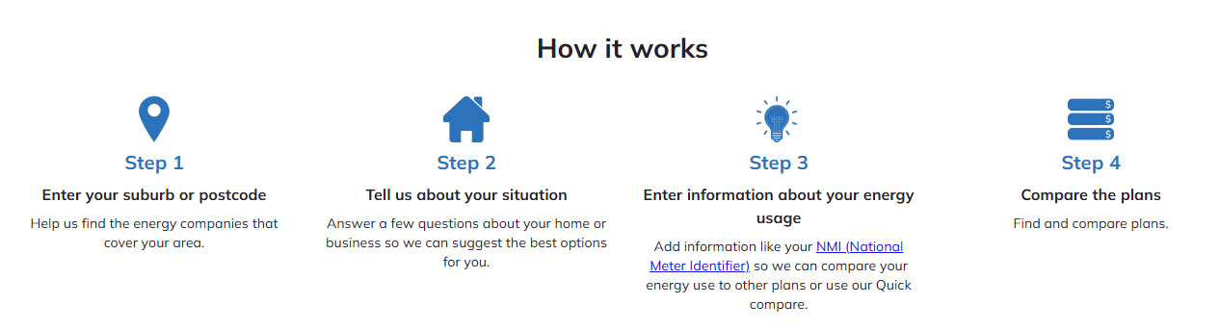
5. Getting the best energy deal
Step 2
Go on the Energy Made Easy website to compare offers from all retailers.
This website is where all retailers need to publish their available energy retail plans.
Notes:
SPEAKER NOTES:
Step 2: Could you save money on another plan?
Shop around for the best deal using the Energy Made Easy.gov.au website
Be aware – your SA Energy concessions does not move with you when you change retailer, you will need to apply or update your details with Concessions SA again.
Check your bill regularly (every 12 months) to make sure you are on the best plan. There could be better deals out there.
Check on Energy Made Easy after July 1 each year – as this is when retailers release their pricing for the next 12 months.
What is DMO? Default Market Offer.
The Default Market Offer (DMO) is a government-set maximum price for electricity, acting as a safety net in NSW, SA and SE QLD. It applies to standing offers for households and small businesses who haven't switched plans. The Australian Energy Regulator (AER) sets it annually to prevent overcharging and provide a reference price for comparing competitive market offers.
You won’t automatically be put on the best energy plan when you sign up with a retailer, plans also expire (i.e. after 12 months) and you will be moved onto your retailers DMO – so you need to keep reviewing your bill to make sure you are on the best plan.

Slide 38
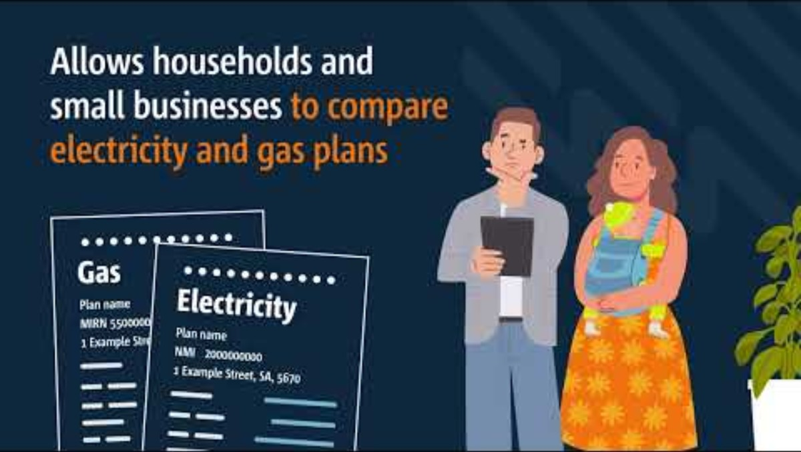
5. Getting the best energy deal
Step 2 Energy Made Easy
Notes:
SPEAKER NOTES:
Let's look at a video about Energy Made Easy
Play embedded video
Link if needed https://youtu.be/7mPdMLHd3ME?si=-aaH2hQJeljlj3to

Slide 39
6 – Concessions and rebates available
Notes:
6 – Concessions and rebates available

Slide 40
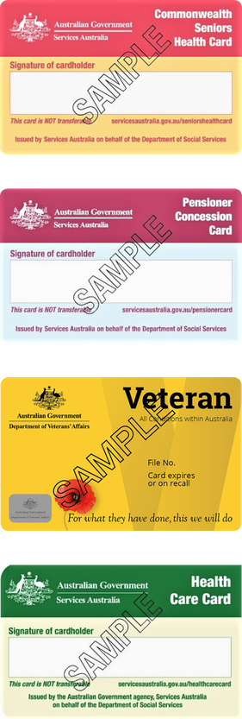
6. Are you a concession card holder?
Do you:
have a Commonwealth concession card such as a
Centrelink Pensioner Concession Card
Low Income Health Care Card
Veteran Gold Card
Commonwealth Seniors Health Card
OR
Receive an eligible* Centrelink payment
And:
Your name is on the electricity bill
OR
You’ve recently moved house
Notes:
SPEAKER NOTES:
Energy concessions (also known as rebates) are a payment (credit) on your bill from the government and are available right now.
Energy concessions is money credited to your electricity bill, and money back in your pocket!
Many people aren’t taking them up.
Why? Because you need to apply to the SA Concessions team, and then it will be applied to your bill.
It doesn’t follow you if you move energy retailers. You need to keep updating these details with the SA Concessions team to keep getting the concession if you move retailers.
How do you know if you’re eligible?
Do you have a Commonwealth concession card such as a Centrelink Pensioner Card, a Low-Income Health Care Card, Veteran Gold Card or Commonwealth Seniors Health Card?
OR receive an eligible Centrelink payment including JobSeeker Payment, Youth Allowance, Parenting Payment, Special Benefit, Self-Employment Allowance, ABSTUDY, Austudy, Farm Household Allowance (FHA), War widow pension under legislation of the United Kingdom or New Zealand.
And is your name on the electricity bill?
Then you could be eligible.
Asylum seekers can also be eligible in SA – more here https://www.sa.gov.au/topics/care-and-support/concessions/asylum-seekers
If you get your energy from your strata or landlord in a caravan park, apartment building or retirement home or village (an embedded network as we mentioned earlier) you could also be eligible; ask your energy provider or contact Concessions SA today. Your energy concession may get credited to your bank account in this situation.
So how do you get an energy concession (or rebate)?
You can apply to the Concessions SA ‘Household Energy Concession’ application form – either online, or printed and posted in.
https://www.sa.gov.au/topics/care-and-support/concessions/household-concessions/household-concessions
Or for more information on concessions (or rebates) including medical concessions if this applies to you:
Visit: https://dhs.sa.gov.au/how-we-help/cost-of-living/concessions/energy-retailers, or
Contact the National Debt Hotline on 1800 007 007 or go to www.ndh.org.au (who we mentioned earlier can help you) for more information first before contacting your energy provider.
Apply or update your details with the online form. The one form covers all four household concessions.
Residential park residents can apply through a separate application form - residential park resident concessions.
If you want to share this messages with others, maybe someone who speaks a language other than English, who uses Auslan (Australian sign language) or who is from a First Nations community, you can send them a flyer or poster from the Energy Charter’s website.
You can see here www.theenergycharter.com.au, the campaign is called Keep the money. It’s yours.
Ref: https://www.theenergycharter.com.au/concessions-awareness-and-engagement-campaign/

Slide 41
6. Are you a concession card holder?
SA Energy Concessions and financial support
Energy concession
Annual value of $281 in 2025/26
Usually paid onto electricity bills
You must update details if you move retailers or address
Must be the listed person on the bill
Apply for ‘household concessions’ to get the Energy Concession
Emergency Electricity Payment Scheme (EEPS)
$800 every 2 years
Emergency payment applied for via a Financial Counsellor or Capability Worker
Assist households that are in financial crisis and unable to pay their electricity debt
SA.GOV.AU-Energy bill concessions
Notes:
SPEAKER NOTES:
SA Energy Concessions and financial support are available to SA customers. The most common concessions are:
Energy concession
Annual value of $281 in 2025/26
Paid quarterly onto electricity bills
You must update details if you move retailers or address
Must be the listed person on the bill
Apply for ‘household concessions’ to get the Energy Concession
Emergency Electricity Payment Scheme (EEPS)
$800 every 2 years
Emergency payment applied for via a financial counsellor
Assist households that are in financial crisis and unable to pay their electricity debt
EXTRAS:
There is also a medical heating and cooling concessions available for eligible conditions, both available via the SA Government.
The Federal government via Services Australia also provides a medical heating and cooling and essential devices concessions.

Slide 42

6. Are you a concession card holder?
SA Concessions Energy Discount Offer
If you’re a South Australian resident and either
hold an eligible concession card, or
receive an eligible Centrelink payment
You can get a guaranteed discount on your electricity and natural gas rates with Origin Energy. These rates are lower than standard plans, with no lock-in contracts and no end date.
Call Origin on 1300 791 465 and ask for the Origin Value plan
Electricity
20% off standard usage and supply charges
Gas
15% off standard usage and supply charges
www.originenergy.com.au/for-home/campaign/origin-value/sa-concession/
Notes:
SPEAKER NOTES:
SA Concessions Energy Discount Offer
The SA Government has an agreement with Origin Energy to provide a gas and electricity discount deal for concession cards holders and Centrelink income recipients.
Its name is shortened to SACEDO and Origin refer to it as the ‘Origin Value’ plan.
It was renewed in January 2026 with the shown discounts (on slide)
They have government contract until at least 2029

Slide 43
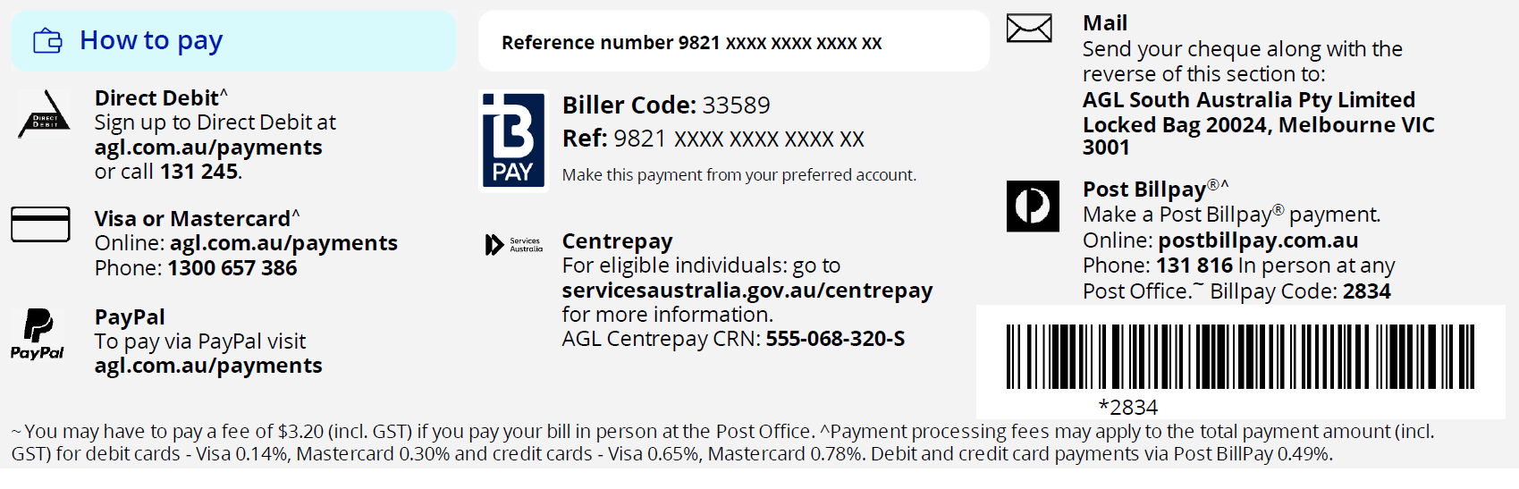
6. Different ways to pay BPAY and Centrepay
1
2
Budgeting tips
Pay your bill every fortnight by BPAY to keep on top of ongoing costs
If receiving a Centrelink income, pay via Centrepay
Bill smoothing
Pay on time to receive discounts (if relevant)
1
2
Notes:
SPEAKER NOTES:
The way you pay for your energy bill can have a big impact on managing your household finances.
Do you or your clients get stressed about their quarterly or monthly bill being due, and not knowing how much they’ll have to pay? When the bill finally comes, the cost is unexpected and hard to pay for by the due date.
This information is to let you know you can pay off your energy bills in advance.
(1) Pay your bill every fortnight to keep on top of ongoing costs (reduces bill shock and makes it less likely to impact other household spending) – you make the decision on how you want to pay it.
BPAY is the easiest way for this as you can set the amount and change it as you need.
(2) If receiving Centrelink income, pay via Centrepay. This can be done with the business directly, on MyGov, Express Plus Centrelink mobile app, by calling or vising Services Australia.
Bill smoothing: Bill Smoothing spreads your yearly energy costs into even, predictable, equal payments. Weekly, fortnightly, or monthly for easier financial planning. Call your retailer or use their online services to check and to set this up, and to discuss an agreed value to pay each fortnight.
- This is usually set up with direct debit – so make sure your bank account has enough money – try setting it up for a day or two after payday. You may be charged fees if there is not enough money in your account.
Pay on time to receive discounts (if relevant) – you’ll know this from your plan information sent to you when you sign up (known as “pay on time” discounts).

Slide 44
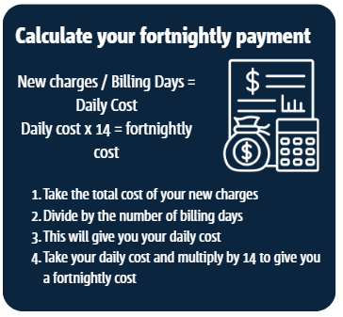
6. Different ways to pay BPAY and Centrepay
1
2
New charges / Billing days
  = daily cost
Daily cost X 14
  = fortnightly cost
Budgeting tips
Pay your bill every fortnight by BPAY to keep on top of ongoing costs
If receiving a Centrelink income, pay via Centrepay
Bill smoothing
Pay on time to receive discounts (if relevant)
1
2
Notes:
SPEAKER NOTES
Calculate your fortnightly payment
There is a calculation to help you figure out how much to pay each fortnight.
This can change seasonally – so if you have your bills for 12 months, add them up and divide by 26 (fortnights).
HANDOUT:
Provide the module 1 handout and discuss how it can help participants stay on top of their energy bill.
Tell participants that handout is available to download from the Talking Power Website.
They can download it to use with clients.

Slide 45
7 – Your take-home action plan
Notes:
7 – Your take-home action plan

Slide 46
7. RECAP – Learning objectives
The main things we wanted you to take away from today:
  How energy connects to the house
  Who to contact for help, including financial support
  How to read your electricity bill
  How to get the best energy deal for you
Notes:
SPEAKER NOTES:
We have covered a lot of information today, a quick recap on the learning objectives:
How electricity connects to the house
Who to contact for help including financial support
How to read your electricity bill
How to get the best energy deal for you

Slide 47
7. GROUP ACTIVITY
Reflection on key learnings
Group Activity
5 minutes
Let’s put that new knowledge into action!
Reflecting on what we have covered today:
What is one helpful thing you now know?
Let’s share as group…..
Notes:
ACTIVITY:
Let’s put that new knowledge into action!
Reflecting on what we have covered – what is one thing you know now?
SPEAKER NOTES:
Let’s share as a group – write down all the things on the whiteboard/paper… go around to each person
Suggestions:
Getting the best plan with my retailer
Energy Made Easy for a better deal
Concessions
Where to get help
Check usage

Slide 48
7. INDIVIDUAL ACTIVITY
Your take-home action plan
Individual Activity
5 minutes
Now let’s put together an action plan!
What are two things you are going to do leaving here today…?
Write down your top 2 things on your take-home action plan
Some suggestions:
  Check your electricity bill:
      does my retailer have a better offer?
      are my concession being applied?
      are you on a flat rate or ToU charge?
  Go on Energy Made Easy website and compare electricity offers
  Contact your retailer and discuss payment options
Notes:
SPEAKER NOTES:
Let’s put that new knowledge into action!
ACTIVITY:
What are two things you are going to do leaving here today…? This will be different for each person; we won’t be sharing these.
This is for you to take home and try to action.
Using your Take Home Action Plan templates, commit to 2 things you can do when you get home.
Write down your top 2 things on your take-home action plan.
Some suggestions:
Check your electricity bill – does your retailer has a better offer?
Check your electricity bill – are my concession being applied?
Check your electricity bill - are you on a flat rate or ToU charge?
Go on Energy Made Easy website and compare electricity offers
Contact your retailer and discuss payment options

Slide 49
Thank you

Slide 50
talkingpower.com.au/electricity-literacy-train-trainer-program
SA Power Networks’ Copyright©
This publication and its contents are the property of SA Power Networks and is copyright protected. SA Power Networks reserves to itself all rights in such material. Not part of this publication is to be reproduced or modified without first obtaining the SA Power Networks’ permission, except as permitted under the Copyright Act 1968.
SA Power Networks’ Disclaimer:
The purpose of this document is to provide general information to assist in the understanding of electricity bills;
Unless otherwise agreed in writing between SA Power Networks and a specific person or entity, SA Power Networks makes no representation that this document is appropriate for any other purpose and, to the extent permitted by law, has no liability to a person who (without SA Power Networks written consent) purports to use the standard for any other purpose. SA Power Networks has made no assessment of any nature whether this standard is appropriate for use in any other circumstance than that noted in paragraph 1.
Nothing in paragraph 2 waives or licences any copyright SA Power Networks has in this document.
This document is subject to change from time to time.

